Slide 1
Recent Developments Regarding Bad Faith Law, Construction Related Claims, and Environmental Claims
Thomas Drennan
Ralph Kooy
Anne Harman
March 26, 2015

Slide 2
INTRODUCTION
Focus:
Recent developments, and “emerging issues,” relating to: 1) insurance bad faith; 2) construction claims; and 3) environmental claims

Slide 3
Recent Developments: Insurance Bad Faith
First-Party Bad Faith:
- Scope of Discovery:
Generally, courts have been expanding the scope of discovery in bad faith actions

Slide 4
Recent Developments: Insurance Bad Faith
Morrison v. Chartis Prop. Cas. Co., 2014 U.S. Dist. LEXIS 58251 (N.D. Okla. April 24, 2014)
UIM claim
Insurer’s post-litigation conduct was discoverable, as final denial took place after litigation began
Relevant inquiry is whether the document was created to aid in likely future litigation

Slide 5
Recent Developments: Insurance Bad Faith
DeMarco v. Allstate Ins. Co., 2014 Ohio App. March 13, 2014)
UM claim
Allstate argued that claim file was “by definition” prepared in anticipation of litigation
Court disagreed – although an insurer’s claim file may be privileged, it is not necessarily privileged, since opening claim files is part of insurer’s ordinary business

Slide 6
Recent Developments: Insurance Bad Faith
Henriquez-Disla v. Allstate Prop. & Cas. Ins. Co. (Various decisions from E.D. Pa.)
Two claims: theft and subsequent fire loss one week later
Issue: attorney-client privilege, and whether counsel were involved in claims functions
Many otherwise protected documents were ordered produced following court’s in camera review

Slide 7
Recent Developments: Insurance Bad Faith
First-Party Bad Faith:
- Impact of the Appraisal Process:
Generally, the appraisal process is becoming more relevant to exposure for bad faith

Slide 8
Recent Developments: Insurance Bad Faith
Scalise v. Allstate Tex. Lloyds, 2013 U.S. Dist. LEXIS 179692 (S.D. Tex. Dec. 20, 2013)
Hail storm loss
Large difference between valuations ($56,881.88 and $423.76)
Appraisal resulted in award of $9,795.30, which insurer promptly paid
Court held that since parties has submitted to appraisal process, insurer’s payment of appraisal award “ended the dispute of any bad faith claim arising from it”

Slide 9
Recent Developments: Insurance Bad Faith
N. Nat’l Bank v. N. Star Mut. Ins. Co., 2012 Minn. App. Unpub. LEXIS 915 (Minn. App. Sept. 17, 2012)
Fire loss – insurer suspected fraud
Mortgagee – not the insured – prosecuted the claim
Insurer initially rejected mortgagee’s demand for appraisal, but court ultimately ordered appraisal, which resulted in an award that was promptly paid
Insurer’s mistake in rejecting appraisal was not bad faith
Minnesota Supreme Court denied petition for further review

Slide 10
Recent Developments: Insurance Bad Faith
Various decisions from Florida, including Lime Bay Condominium, Inc. v. State Farm Florida Ins. Co., 94 So.3d 698 (Fla. 4th DCA August 15, 2012); Trafalgar at Greenacres, Ltd. v. Zurich Am. Ins. Co., 100 So.3d 1155 (Fla. 4th DCA Sept. 5, 2012); Cammarata v. State Farm Fla. Ins. Co., 2014 Fla. App. LEXIS 13672 (Fla. 4th DCA Sept. 3, 2014)

Slide 11
Recent Developments: Insurance Bad Faith
All property damage cases resulting from Hurricane Wilma
Lime Bay: Appraisal award was not final determination on breach of contract claim, and therefore bad faith claim could not proceed
Trafalgar: Appraisal award was “favorable resolution” – and therefore bad faith claim could proceed
Cammarata: As in Trafalgar, bad faith claim could proceed

Slide 12
Recent Developments: Insurance Bad Faith
First-Party Bad Faith:
- Scope of First-Party Bad Faith Statutes:
Generally, first-party bad faith has become more statutory in nature

Slide 13
Recent Developments: Insurance Bad Faith
DRH Horton, Inc. v. Mt. States Mut. Cas. Co. (Various decisions from D. Colorado)
Traditional “third-party” situation
Insureds were subcontractors potentially liable for construction defects – tendered as additional insureds under various policies
Filed suit against insurers for failure to defend, and bad faith
Court held that the insureds were “first-party claimants” under Colorado bad faith statute, which was applicable

Slide 14
Recent Developments: Insurance Bad Faith
Third-Party Bad Faith:
- Procedural Bad Faith:
Increasingly, courts are addressing the possibility for bad faith exposure even in the absence of coverage

Slide 15
Recent Developments: Insurance Bad Faith
St. Paul v. Onvia, 165 Wn.2d 122 (Wash. November 26, 2008)
- Under Washington law, every insurer has a duty to act promptly in communication and investigation
- These are necessary obligations read into every policy
- The duty of good faith is “broad and all encompassing,” and is not limited to an insurer’s duty to pay, settle, or defend
- Therefore, a third party insured has a cause of action for bad faith claims handling that is not dependent on the duty to indemnify, settle, or defend

Slide 16
Recent Developments: Insurance Bad Faith
Capstone Building Corp. v. American Motorists Ins. Co., 2013 Conn. LEXIS 187 (June 11, 2013)
Connecticut Supreme Court declined to recognize a bad faith cause of action based solely on an insurer’s failure to investigate a claim
Bad faith claim requires a plaintiff to demonstrate that the allegedly wrongful conduct deprived the plaintiff of some benefit of the parties’ insurance agreement

Slide 17
Recent Developments: Insurance Bad Faith
Klepper v. ACE American Ins. Co., 999 N.E.2d 86 (Ind. Ct. App. 2013)
Indiana Court of Appeals permitted a bad faith claim to proceed despite having found that the policy did not indemnify the insured’s loss, and that the insurer’s denial of coverage was correct

Slide 18
Recent Developments: Insurance Bad Faith
Third-Party Bad Faith:
- Affirmative Duty to Settle Without Demand:
Several courts have held that insurer’s may have an affirmative duty to settle even in the absence of a formal demand

Slide 19
Recent Developments: Insurance Bad Faith
Jaimes v. GEICO General Ins. Co., Nos. 12-14427 and 13-10847, 2013 U.S. App. LEXIS 16898 (11th Cir. (Fla.) 213)
- Factual dispute as to whether insurer attempted to contact the claimant following an automobile accident
- The court held that the insurer acted in bad faith by failing to offer policy limits until 104 days after the accident – and after suit had been filed

Slide 20
Recent Developments: Insurance Bad Faith
Travelers Indemnity of Connecticut v. Arch Specialty Ins. Co., 2013 U.S. Dist. LEXIS 169453 (E.D. Cal. 2013)
Insurer may have affirmative duty to settle even in the absence of a formal demand, and may be exposed to bad faith for failure to settle

Slide 21
Recent Developments: Insurance Bad Faith
But see Reid v. Mercury Insurance Company, 220 Cal. App. 4th 262 (Cal.App. 2nd Dist. Oct. 7, 2013)
Insurer not exposed for bad faith if no demand or opportunity to settle

Slide 22
Recent Developments: Insurance Bad Faith
Scottsdale Ins. Co. v. Addison Ins. Co., 2013 Mo. App. LEXIS 1141 (Mo. App. October 1, 2013)
Appellate Court - Bad faith exposure even without formal demand
Scottsdale Ins. Co. v. Addison Ins. Co., No. SC93792 (Mo. December 9, 2014)
Supreme Court – though not explicit, the court suggested that bad faith exposure is possible without formal demand, if the insurer intentionally disregards the insured’s financial interests

Slide 23
Recent Developments: Insurance Bad Faith

Slide 24
Introduction
Construction Law Update
Recent Surety Cases
Recent Coverage Decisions in Construction
Intersection of Surety and Insurance Law

Slide 25
Construction Law Update
Spectro Alloys Corp. v. Fire Brick Eng’rs Co., Inc., 2014 U.S. Dist LEXIS 140817 (D. Minn. Oct. 3, 2014) (Minnesota federal court rejected owners’ implied warranty claims against installation contractor, and held recovery of lost profits barred by limitation of damages clause)

Slide 26
Construction Law Update
C. Szabo Contracting, Inc. v. Lorig Construction Co., 2014 Ill. App. LEXIS 699 (Ill. App. Sept. 29, 2014) (Illinois court held that sub-contractor could seek relief under unjust enrichment theory for work requested, but not paid for, by general contractor)

Slide 27
Construction Law Update
Beacon Residential Community Association v. Skidmore, Owings and Merrill LLP (2012) 211 Cal.App.4th 1301 (California Supreme Court recently agreed to review this decision, in which the appellate court reversed the trial court, and held that the Right to Repair Act imposed potential third party liability upon design professionals, and supported a claim by a homeowner’s association even though the association had not contracted directly with the architects)

Slide 28
Construction Law Update
The School Board of Broward County, Florida v. Pierce Godwin Alexander & Linville, 137 So.3d 1059 (Fla. 4th DCA 2014) (court addressed an architect’s standard of care, and the “first cost” defense)

Slide 29
Construction Law Update
American Family Mut. Ins. Co. v. Plunkett, No. 12 L 11528 (Ill. App. 1st Dist. June 27, 2014) (waiting for claim assignment doesn’t toll statute of limitations)

Slide 30
Recent Surety Cases
Advanced Automatic Sprinkler Co., Inc. v. Seaboard Surety Co., Inc., No. 650321/2001, N.Y.L.J. 1202678994141, at *1 (Sup. Ct. New York County Dec. 3, 2014) (New York court reaffirmed limits to surety’s liability on a delay claim made under a payment bond)

Slide 31
Recent Surety Cases
Minn. Laborers Health & Welfare Fund v. Granite Re, Inc., 844 N.W.2d 509 (Minn. 2014) (the deadline to assert a bond claim against a surety can be suspended if the facts are fraudulently concealed, even if the surety had no knowledge of the fraudulent concealment)

Slide 32
Recent Surety Cases
Niles-Wiese Construction Co., Inc. v. Westfield Ins. Co., No. A12-0370 (Minn. 2013) (claimant under a payment bond must comply with statutory notice requirement in terms of service to a contractor)

Slide 33
Recent Surety Cases
Upper Pottsgrove Township v. International Fidelity Insurance, No. 13-1758 (E.D. Pa. Oct. 2, 2013) (surety agreement is not an “insurance policy” for the purposes of Pennsylvania’a bad faith statute)

Slide 34
Recent Coverage Decisions in Construction
Chartis Specialty Ins. Co. v. Am. Contractors Ins. Co., 2014 WL 3943722 (D. Ore. Aug. 12, 2014) (allegations of “deficiently managed construction” constituted a single occurrence for coverage purposes)

Slide 35
Recent Coverage Decisions in Construction
Crownover v. Mid-Continent Cas. Co., No. 11-10166 (5th Cir. Oct. 29, 2014) (applying Texas law) (contractual liability exclusion did not apply to preclude coverage for contractor’s obligation to repair defective work)

Slide 36
Recent Coverage Decisions in Construction
State Farm Fire & Cas. Co. v. McDermott, 2014 WL 5285335 (E.D. Pa. Oct. 15, 2014) (damage to home due to water intrusion was caused by faulty workmanship, and did not constitute an occurrence under a CGL policy)

Slide 37
Recent Coverage Decisions in Construction
The Intersection Between Insurance Coverage and Surety
Surety’s Claims By Assignment and Subrogation
Builder’s Risk Coverage
Commercial General Liability Coverage

Slide 38
Construction-Related Claims: Emerging Issues

Slide 39
Environmental Claims: Defense and Coverage Issues
Recent Developments Concerning Defense of Environmental Claims:
Public Nuisance—green house gases, lead paint
Isotope Analysis—what is it and is it admissible?
Asbestos Update—mesothelioma, lung cancer, take-home claims, evolving defenses, recent verdicts, workers comp and legislative efforts

Slide 40
Public Nuisance
PUBLIC NUISANCE Green House Gases (GHG)
American Electric Power Co. v. Connecticut ,131 S. Ct. 582 (U.S. 2011)--is there a federal common law nuisance claim for GHG emissions?
8 states, NYC and 3 land trusts sued five power companies to abate GHG emissions 2004
US Supreme Court reversed 2d Circuit (NY) stating EPA is regulating GHG emissions via Clean Air Act and its related actions, so “hands-off, federal courts”.

Slide 41
What does this mean for us?
There is a federal “common law” and related rights, but……
Justice Ginsburg reminds the federal courts that it’s not their job to make policy and have federal agencies interpret the policy, but rather, the opposite.
The question is “whether the field has been occupied, not whether it has been occupied in a particular manner.” Milwaukee II, 451 U.S. 304
“[P]ublic Nuisance law, like common law generally, adapts to changing scientific and factual circumstances.” Missouri, 200 U.S. 496

Slide 42
Public Nuisance Lead Paint Litigation
State of California v. Atlantic Richfield Co.
In 2000, Santa Clara County sues Atlantic Richfield, Sherwin Williams, ConAgra, NL Industries and DuPont for public nuisance seeking abatement of lead paint [Atl. Richfield and DuPont dismissed by court].
January 7, 2014, Judge James Kleinberg of Santa Clara county issues decision, finding SW, ConAgra and NL created a public nuisance by promoting and selling (interior) lead paint despite knowing toxicity.

Slide 43
Lead Paint
Remedy: $1.1 billion payable to Childhood Lead Poisoning Prevention Branch to abate with priority given to properties housing children. Replace or maintain.
Sept. 2014—Feb. 2015, briefs and appeals being filed. Amicus briefs due 2/20/15.
Appellate issues: failure to define “the” public nuisance(s); scope and duration of conduct; nexus between conduct (selling & promoting lead paint use) and remedy (abatement).

Slide 44
ISOTOPE ANALYSIS
What is Isotope Analysis? Identification of an isotopic ‘signature’
useful in understanding links between source compound and final location of that compound
common scientific process but its forensic application in litigation is new and still up for debate
are two chemically indistinguishable and correspondent compounds truly “the same?”
Is it admissible?
City of Pomono v. SQMNA Corp., 750 F.3d 1036 (9th Cir. 2014) cert den US 12/15/14.

Slide 45
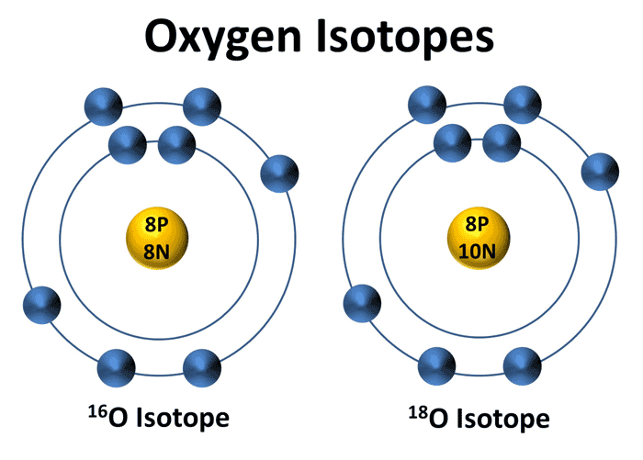
Isotope--an atom that is missing a neutron or has an extra neutron.
It’s still the same element, just a bit different from the other atoms of the same element.
Radioactive decay—the loss of neutrons, happens over time. “Carbon dating” used by archaeologists to age an object.
Not all isotopes decay—these are “stable isotopes”.

Slide 46
What Are Stable Isotopes?
Stable isotopes—isotopes not subject to radioactive decay—majority of isotopes are stable and do NOT decay.
Minute differences in atomic mass have measurable and quantifiable effects and thus identical compounds aren’t truly identical.
Forensic/litigation use of stable isotopic analysis attempts to look for and identify these minute differences, then using that, assign the origin of the compound based upon those differences.
Issues:

Slide 47
Daubert, FRE 702 and Isotope Analysis
FRE 702 requires that scientific evidence be both relevant and reliable.
Daubert (1993)—Judge is gatekeeper for expert (scientific) evidence presented to jurors.
City of Pomona v. SQMNA Corp., 750 F.3d 1036 (9th cir. 5/2/14) cert den U.S. 12/15/14; City alleges use of stable isotope analysis measures the weight of atoms of same element within a substance—here, substance is perchlorate in the city’s water supply. Comparison of that weight to samples of SQMNA’s fertilizer will indicate identical atomic weight of substances, and thus link up the specific fertilizer to the specific water pollutant.

Slide 48
City of Pomona v. SQMNA Corp.
USDC (Ctrl Dist of CA) excluded the testimony and opinion of the City’s “expert” Neil Sturchio, Ph.D. which purported to establish identity/signature of pollutant via isotopic analysis of percholorate in water and fertilizer/product: finding method not generally accepted, procedure untested, not capable of retesting due to flawed/limited sampling, database of substance is too limited and error rate unacceptable.

Slide 49
City of Pomona v. SQMNA Corp, cont’d…
9th Circuit reversed and remanded, saying “[f[acts casting doubt on the credibility of an expert witness and contested facts regarding the strength of a particular scientific method are questions reserved for the fact finder.”
U.S. Supreme Court denied certiorari 12/15/14
Last Supreme Court review of Daubert was in1997 with GE v. Joiner , then 1999 with Kumho Tire v. Carmichael (all expert testimony, not just scientific, subject to court’s gatekeeping) and lastly in 2000 with codified amendments to 702 and gatekeeping standard.
Take away—9th Circuit is activist (surprise); plan your Daubert /Frye challenges early and often; Federal Courts still the best place for these battles due to sophistication of judges.

Slide 50
Lawyers, Judges & Jurors are NOT Scientists
“The courtroom is not the place for scientific guesswork, even of the inspired sort. Law lags science; it does not lead it.” Rosen v. Ciba-Geigy Corp., 78 F.3d 316, 319 (7th Cir. 1996, Posner, J.).

Slide 51
ASBESTOS Litigation Update
Filings—mesothelioma claims staying steady at about 3,000 diagnosed annually, with a large number(>75%) ending up in court system.
Plaintiffs continue to push for consolidations—based upon similar worksite, job classification, disease, employer. Higher verdicts in consolidations.
Mesothelioma secondary exposure/take-home cases—increased filings—women young and old. Children and spouses of industrial workers. High damage potential.
Defenses: bare metal defense (is equip mfr liable for 3d party parts?), “each & every exposure” causation, fiber type, statute of repose, workers comp.
Lung cancer—filings—increases everywhere. Look for alternative causation

Slide 52
ASBESTOS Litigation Update
Legislative Updates:
U.S. FACT Act (H.R. 526 1/26/15)—hearings on 2/4/15—state legislative actions—WV
Garlock Sealing Technologies, LLC [2010 Chp 11 filing in NC Fed Ct.] Estimation Trial Court:
Garlock's settlement history cannot be used to estimate its liability for mesothelioma claims because the past settlement values "are infected with the impropriety of some law firms and inflated by the cost of defense.

Slide 53
Venue for Lung Cancer
Madison County, Illinois
Others – California, New York, Pennsylvania, Delaware, West Va.
Forum Non conveniens
Personal Jurisdiction

Slide 54
The Growing Trend in Lung Cancer Filings
1,400
1,200
1,000
800
600
400
200
0

Slide 55
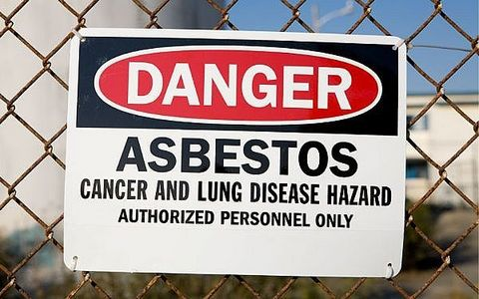
Lung Cancer: A Case of Asbestos?
Smoking is estimated to be a contributing factor in 90% of lung cancer cases
Occupational carcinogen exposures, including asbestos, uranium, and coke are estimated to contribute to 9-15% of cases
Radon exposure is estimated to contribute to 10% of cases
General outdoor pollution is estimated to contribute to 1-2% of cases

Slide 56
Overview: Lung-Cancer Related Asbestos Trials 2012-2014
9 trials from 2012-2014
6 Defense Verdicts
5 of the cases involved Plaintiffs who were smokers
3 Plaintiff Verdicts
2 of the cases were consolidated cases with more than one Plaintiff
2 of the cases assessed 50% or more to Plaintiff’s negligence
2 of the cases resulted in initial awards in excess of $2M

Slide 57
Defense Verdicts (2012-2014)
Defense Theory: Insufficient product identification and Plaintiff’s extensive smoking history
2013, California
Plaintiff smoked two packs of cigarettes a day for over 50 years
Defense Theory: insignificant exposure to Defendant’s products; expert opined Plaintiff had unique gene mutation
2013, Florida
Plaintiff was a non-smoker
Defense Theory: Product was not a substantial factor
2013, New York
Plaintiff was a cigarette smoker
Jury determined that Plaintiff did suffer exposure to Defendant’s asbestos but not a substantial factor in Plaintiff’s disease

Slide 58
Defense Verdicts Cont’d (2012-2014)
Defense Theory: Plaintiff smoked cigarettes; none of the gaskets the Plaintiff was exposed originated with the Defendant; any exposure to asbestos from gaskets was de minimus
2013, Pennsylvania
Plaintiff 85% liable for his lung cancer; Defendant 15% liable
Plaintiff’s liability completely negated the liability of Defendant
Defense Theory: Plaintiff never exposed to Defendant’s product; Plaintiff never showed evidence of pneumoconiosis; Plaintiff smoked two to three packs of cigarettes per day for over 40 years
2014, Illinois
Defense Theory: Plaintiff smoked cigarettes; Plaintiff exposed to secondhand smoke
2014, Illinois
70% of responsibility of disease was Plaintiff’s use of cigarettes; 10% due to secondhand smoke; 20% to co-workers working with asbestos at other job sites

Slide 59
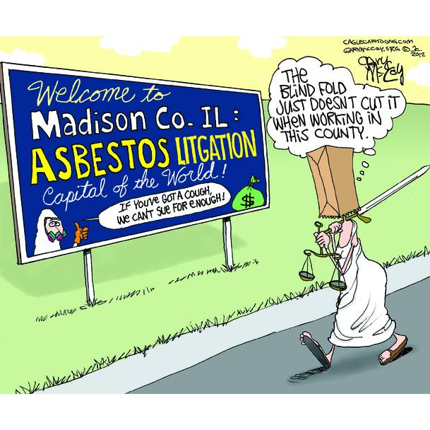
Plaintiff Verdicts (2012-2014)
Verdict: 2.1M
Illinois, 2014
2 Consolidated cases (1 was lung cancer)
Lung cancer plaintiff awarded $768,00 which was reduced to $384,000 after finding plaintiff was 50% negligent due to his own cigarette smoking
Verdict: $250,000
Illinois, 2013
Assessed 20% to defendant and 80% to plaintiff- defendant paid $50,000 to plaintiff
Defense: Plaintiff had two competing cancers at time of death, had other risk factors for lung cancer including rheumatoid arthritis and the use of immuno-suppressant drugs to treat the condition, and smoked for many years

Slide 60
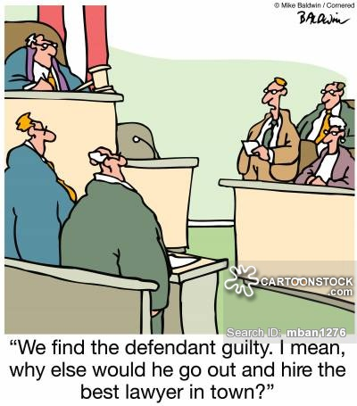
Plaintiff Verdicts (2012-2014) Cont’d
Verdict: $190M
2013, New York
5 consolidated cases; 2 were lung cancer. The 2 lung cancer plaintiffs received $90M in total
Plaintiff’s counsel claimed that the Defendants had distributed literature that acknowledged they manufactured asbestos but provided no warnings of its danger

Slide 61
Review
Asbestos-related lung cancer claims on the rise
Rise can be contributed by willingness of trusts to pay non-Mesothelioma claims which has created an economic incentive for mass non-malignant screenings and lung cancer recruitment
Unlike Mesothelioma which has strong casual links to asbestos exposure, lung cancer comes from a variety of risk factors
However Plaintiffs are frequently arguing the alleged “synergistic” effect that increases the risk of lung cancer when smoking combined with asbestos exposure
Be wary of contributory negligence states that will not apportion indivisible damages to Plaintiff

Slide 62
Recent NYCAL Verdicts • Koczur and McCarthy (2011)
• Two deceased smoking lung cancer cases
• Pain and Suffering
Koczar- $13,650,000 (reduced to $6,500,000 on post-trial motion)
McCarthy- $8,500,000 (sustained on post-trial motion)

Slide 63
U.S. Lung Cancer Rates
In 2011 (the most recent year numbers are available)—
207,339 people in the United States were diagnosed with lung cancer, including 110,322 men and 97,017 women.*†
156,953 people in the United States died from lung cancer, including 86,736 men and 70,217 women.*†
*Incidence counts cover about 99% of the U.S. population; death counts cover about 100% of the U.S. population. Use caution when comparing incidence and death counts.
†Source: U.S. Cancer Statistics Working Group. United States Cancer Statistics: 1999–2011 Incidence and Mortality Web-based Report. Atlanta (GA): Department of Health and Human Services, Centers for Disease Control and Prevention, and National Cancer Institute; 2014.

Slide 64
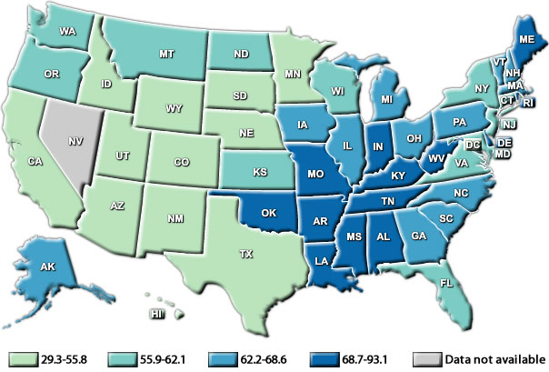
U.S. Lung & Bronchus Cancer Incidence
Notes:
†Source: U.S. Cancer Statistics Working Group. United States Cancer Statistics: 1999–2011 Incidence and Mortality Web-based Report. Atlanta (GA): Department of Health and Human Services, Centers for Disease Control and Prevention, and National Cancer Institute; 2014. Available at: www.cdc.gov/uscs

Slide 65
CIGARETTE SMOKING
Cigarette smoking-#1 risk factor for lung cancer. In the US, smoking is linked to about 90% of lung cancers. Cigar or pipe usage also increases the risk for lung cancer. Tobacco smoke is a mix of more than 7,000 chemicals. At least 70 are known to cause cancer in people or animals.
People who smoke cigarettes are 15 to 30 times more likely to get lung cancer or die from lung cancer than people who do not smoke.
People who quit smoking have a lower risk of lung cancer than if they had continued to smoke, but their risk is higher than the risk for people who never smoked.
Notes:
CDC

Slide 66
SECONDHAND SMOKE
Nonsmokers exposed to secondhand smoke at home or at work increase their risk of developing lung cancer by 20–30%.
Secondhand smoke causes > 7,300 lung cancer deaths among U.S. nonsmokers annually.
Nonsmokers are inhaling many of the same cancer-causing substances as smokers.
As with active smoking, the duration and level of exposure to secondhand smoke impacts risk of developing lung cancer.
Notes:
U.S. Department of Health and Human Services. The Health Consequences of Smoking—50 Years of Progress: A Report of the Surgeon General. Atlanta: U.S. Department of Health and Human Services, Centers for Disease Control and Prevention, National Center for Chronic Disease Prevention and Health Promotion, Office on Smoking and Health, 2014 [accessed 2014 Mar 5].

Slide 67
RADON
Radon is a naturally occurring gas that comes from rocks and dirt and can get trapped in houses and buildings. It cannot be seen, tasted, or smelled.
U.S. Environmental Protection Agency (EPA), says radon causes about 20,000 cases of lung cancer each year, making it the second leading cause of lung cancer. Nearly one out of every 15 homes in the U.S. is thought to have high radon levels.
US Geological Survey 1993—some western, mid-western, mid-atlantic and northeast homes have areas where greater than 15-20% of home have indoor levels over the 4 pCi/L
Notes:
pCi/L picocuries per litre
Decay rates

Slide 68
Notes:
USGS 1993 Report 93-292 complied by 42 states between 1986-92
Note that this is state average—within a state, say PA, certain areas are quite high: Washington Co. PA—over one-half of its home readings exceed 4 pCi/L, with an average of 8.1 pCi/L.
Philadelphia and Delaware Counties have average of <4pCi/L.
Illinois—home of Cook Co and Madison Co. asbestos litigation—32% of homes had levels over 4 pCi/L

Slide 69
OTHER SUBSTANCES
Some workplace substances that can increase risk include: asbestos, arsenic, chromium, formaldehyde, diesel exhaust, nickel, and some forms of silica. For some of these substances, the risk of getting lung cancer is even higher for those who smoke.
Radiation therapy to chest--therapeutic
Family History—certain cancers
Problem with all other potential causes/substances (except asbestos and silica)—no hallmark signature left in lungs or body such that it can be medically identified, quantified and causally related.

Slide 70
WHAT DOES THIS MEAN?
Defending lung cancer cases is vastly different from defending mesothelioma cases. Medical and factual defenses available.
Discovery process—devote planning, preparation, time, money, experts and old-fashioned investigative skills; Ask where did plaintiff grow up, smoking in home, school setting (abatement documents), worksites/product manufactured, i.d. alternate exposures.
Smoking is easy, but the more potential carcinogens you identify, the less “culpable” your asbestos-containing product . Common sense: Joe Plaintiff’s parents both smoked a pack a day his entire 18-years with them, his teachers smoked at school, he smoked from high school onward until diagnosed, his co-workers smoked around him, his wife smoked until she quit in 1990. But changing the gasket on a flanged valve on a 2” pipe is what gave him cancer?

Slide 71
Recent Pennsylvania Significant Decisions
A new era in Pennsylvania Product Liability Law:
Tincher v. Omega Flex, Inc., 64 A.3d 626 (Pa. 2014)
-rejected Restatement Torts, 3d
-expressly overrules Azzarello after 36 years
-changes to product defect jury instructions
-”consumer expectation” theory OR
“risk/utility” balancing are the tests
-manufacturer no longer “guarantor” of safety

Slide 72
Changes to PA Workers Comp Law
Tooey v. AK Steel Corp., et al., 81 A.3d 851 (PA 2013)
-overturned prior exclusivity of comp system
for latent occupational diseases
-involved asbestos exposures during employment
-increases premise owner’s potential liab to e’ees
-coverage issues under GL and Work Comp policies

Slide 73
Statute of Repose Applicable In Asbestos Cases
Graver v. Foster Wheeler Corp., 2014 Pa. Super. 132 (July 2014)
references Abrams v. Pneumo Abex Corp., 981 A.2d 198 (Pa. 2009)
should eliminate design and construction asbestos claims
equipment defendants have potential defense
2/15 PA Supreme Court denies Appeal—ruling stands

Slide 74
Environmental Claims: Defense and Coverage Issues
Recent Developments Relating to Coverage for Environmental Claims:
1) Pollution Liability Policies

Slide 75
Environmental Claims: Defense and Coverage Issues
Pennzoil-Quaker State Co. v. Am. Int’l Specialty Lines Co., 653 F.Supp.2d 690 (2009)
Timely reporting of one class-action did not provide de facto notice of second class-action suit

Slide 76
Environmental Claims: Defense and Coverage Issues
Federal Ins. Co. v. Cherokee Ardell LLC, 2011 WL 1254036 (D. N.J. 2011)
Estoppel did not apply to require coverage for cleanup costs incurred after policy term expired

Slide 77
Environmental Claims: Defense and Coverage Issues
Indian Harbor Ins. Co. v. City of San Diego, No. 13-4244-CV (2nd Cir. 2014)
Two month delay in providing notice of noxious gas emanating from sewer system was unreasonable, and constituted late notice

Slide 78
Environmental Claims: Defense and Coverage Issues
URS Corp. v. Zurich American Ins. Co., 979 N.Y.S.2d 506 (2014)
Smoke from fire did not constitute a “pollution condition”

Slide 79
Environmental Claims: Defense and Coverage Issues
Recent Developments Relating to Coverage for Environmental Claims:
2) Pollution Exclusions

Slide 80
Environmental Claims: Defense and Coverage Issues
Apana v. TIG Ins. Co., 574 F.3d 679 (9th Cir. 2009)
Collecting cases – good summary of developments in the application of pollution exclusions

Slide 81
Environmental Claims: Defense and Coverage Issues
Am. States Ins. Co. v. Koloms, 177 Ill.2d 473 (1997)

Slide 82
Environmental Claims: Defense and Coverage Issues
Post Koloms decisions:
Country Mut. Ins. Co. v. Hilltop View LLC, 2013 IL App (4th Dist.) 130124 (Ill. App. 2013)
Greenwich Ins. Co. v. John Sexton Sand and Gravel Corp., 2013 IL App (1st Dist.) 121263-U (Ill. App. 2013)

Slide 83
Environmental Claims: Defense and Coverage Issues

