Slide 1





CYBER SECURITY CONFERENCE 2017

Slide 2
Linda Grahovec, Fidelity National Title Group
DEFINING CYBERSECURITY (by HOMELAND SECURITY)
Our daily life, economic vitality, and national security depend
on a stable, safe, and resilient cyberspace.
Cyberspace and its underlying infrastructure are vulnerable to a wide range of risk stemming from both physical and cyber threats and hazards. Sophisticated cyber actors and nation-states exploit vulnerabilities to steal information and money and are developing capabilities to disrupt, destroy, or threaten the delivery of essential services.
REAL TIME CYBERSECURITY THREAT MAP

Slide 3
Terminology - NPPI & PII Defined
Non-public Personal Information (“NPPI”):
  Personally identifiable data such as information provided by a customer on a form or application, information about a customer’s transactions, or any other information about a customer which is otherwise unavailable to the general public.
  NPPI includes first name or first initial and last name coupled with any of the following:
    Social Security Number
    Driver’s license number
    State-issued ID number
    Credit or debit card number
    Other financial account numbers
    NYS DFS CyberSecurity Amended Regulations: Have narrowed their broad definition of Nonpublic Information to “Business Related” information (§500.01 (g)) (earlier version covered “any information, not Nonpublic or business-related information).
Personally identifiable information (PII):
Any data that could potentially identify a specific individual.
Any information that can be used to distinguish one person from another and can be used for de-anonymizing anonymous data can be considered PII

Slide 4
THE ASSETS TO BE PROTECTED
Common “Transactional-Settlement” Documents Containing NPPI | Common “Loan Process” & Related Purchase Documents Containing NPPI
Uniform Residential Loan Application (Form 1003) (NPPI includes: SSN, bank account numbers, loan numbers, work addresses, etc.) | Contracts of Sale
Borrower Tax Returns (NPPI includes: SSN, financial information, address) | Lender Pre-Approval letters
Closing Disclosure “CD” (NPPI includes: loan number, address) | Payoff Letter (NPPI includes: Bank account numbers, loan number, address)
Identification (Driver’s License, passport, etc.) (NPPI includes: address, birthdate, ID number, Passport number) | Coop or Condo “Board Package”
Payoff Letter (NPPI includes: Bank account numbers, loan number, address) | Credit Reports
IRS Form 4506-T, Request for Transcript of Tax Returns (NPPI includes: SSN, address)
IRS Form W-9, Request for Taxpayer Identification Number and Certification (NPPI includes: SSN, address)

Slide 5
ALTA BEST PRACTICES – PILLAR #3
Physical security of Non-public Personal Information.
  Restrict access to Non-public Personal Information to authorized employees who have undergone Background Checks at hiring.
  Prohibit or control the use of removable media.
  Use only secure delivery methods when transmitting Non-public Personal Information.
Network security of Non-public Personal Information.
  Maintain and secure access to Company information technology
  Develop guidelines for the appropriate use of Company information technology.
  Ensure secure collection and transmission of Non-public Personal Information.
Disposal AND MAINTENANCE of Non-public Personal Information.
  Federal and state laws require companies that possess records containing non-public personal information to maintain and dispose of such records (incl electronically-stored records) in a manner that protects against unauthorized access to or use of the Non-public Personal Information.
  Companies must securely maintain and dispose of records containing NPPI pursuant to an established timeframe for retaining records, as documented in Company’s information security program, that takes into consideration the appropriate legal, regulatory and business requirements.

Slide 6
ALTA BEST PRACTICES – PILLAR #3
Establish a disaster management plan.
Appropriate management and training of employees to help ensure compliance with Company’s information security program.
Oversight of service providers to help ensure compliance with a Company’s information security program.
  Companies should take reasonable steps to select and retain service providers that are capable of appropriately safeguarding Non-public Personal Information.
Audit and oversight procedures to help ensure compliance with Company’s information security program.
  Companies should review their privacy and information security procedures to detect the potential for improper disclosure of confidential information.
Notification of security breaches to customers and law enforcement.
  Companies should post the privacy and information security program on their websites or provide program information directly to customers in another useable form. When a breach is detected, the Company should have a program to inform customers and law enforcement as required by law.

Slide 7
Jessica Edgerton
EDUCATION
EMAIL HYGIENE
I.T. SECURITY
PREVENTION

Slide 8


Slide 9
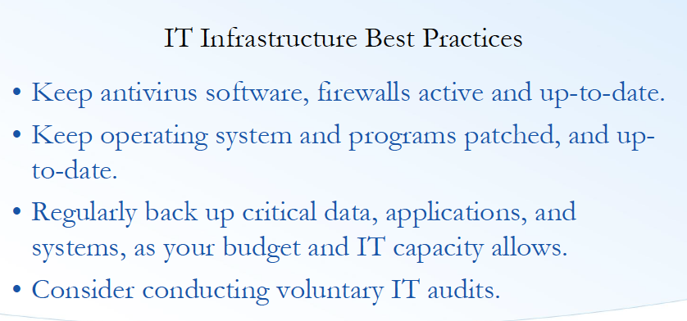

Slide 10
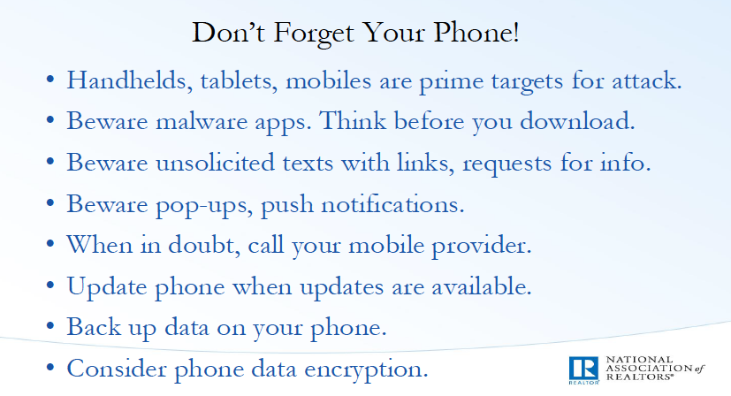

Slide 11
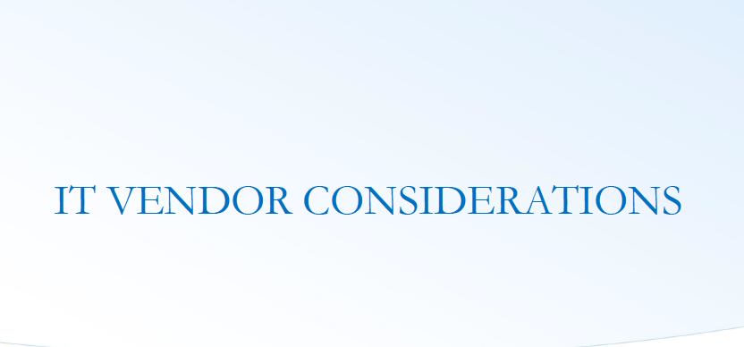

Slide 12
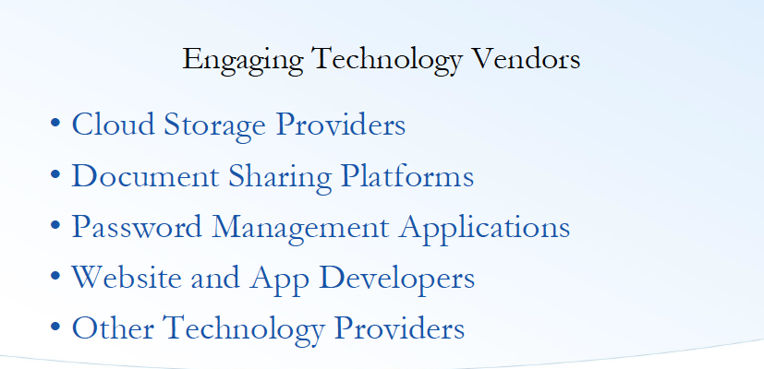

Slide 13
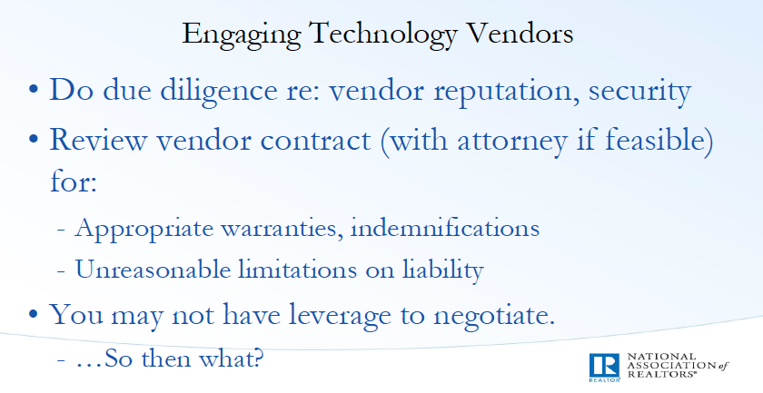

Slide 14
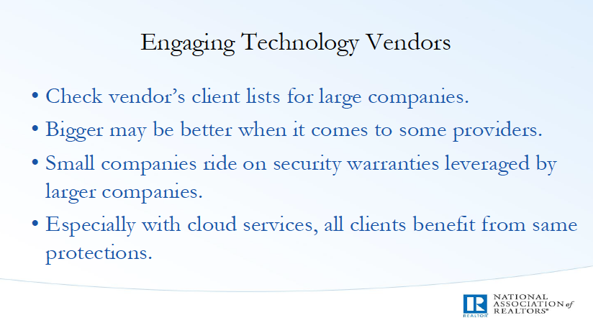

Slide 15
Erin Tracey-Jenner, Greater Illinois Title
TALES FROM THE CLOSING TABLE
Intercepted Wire Instructions
Inadequate email domains
Last minute changes

Slide 16
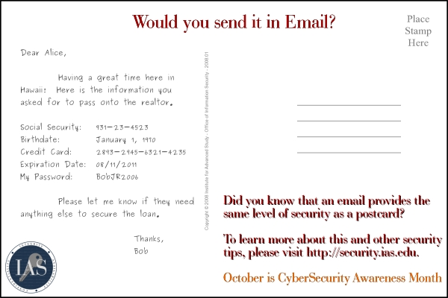


AVOID WIRE FRAUD – STEPS TO TAKE
There are three practices we would recommend all FNF employees, agents and business partners follow to protect against Wire Fraud:
Only use email that provides two factor authentication and make sure it is enabled.
Never wire funds based upon the content of an email only. Always assume email has been compromised somewhere along the way and validate all information over the phone of a trusted phone number.
If our agents or employees suspect a wire or check was sent fraudulently, we recommend that they immediately notify their bank and contact the recipient bank to have the best chance at securing the funds.

Slide 17
AVOID WIRE FRAUD – STEPS TO TAKE
DO:
DON’T DO:
Call the Buyer or Buyer’s Agent on a known-good telephone number, explain that your title company has not received their funds, and ask them to confirm that they wired the funds to the correct bank account of the settlement agent.
If they confirm that they wired funds to a different bank account, inform them that they should immediately contact their bank to issue a recall of the wire due to fraud.
Contact your manager, IT personnel and your bank immediately
  Include summary of the facts (who, what, when, how) about the wire from the buyer:
    Information about the bank account that received the funds incorrectly:
      ABA routing number
      Bank Account number
      Account owner name on the wire instructions
Attach the email that you sent to the Buyer of Buyer’s Agent that contained the correct wire instruction for sending funds to close.
Call the Buyer or Buyer’s Agent on a known-good telephone number, and ask them to provide the email that the Buyer received.
DO NOT say or write, either in internal email or with outside parties, something to the effect that “your email was hacked” The Title Company has an IT security framework in place such that it is unlikely that their email account was hacked – in these wire fraud situations, outside parties to the transaction are very likely the source of the compromise of the transaction details.
Create your Company Policy and Procedures.
DO NOT discuss the situation to outside parties – an investigation needs to be conducted by the appropriate party in order to determine if any such wire fraud may result in liability.
DO NOT continue to communicate with persons you believe may not be proper parties to the transaction. Ignore further emails or other request for an update.

Slide 18
Robert Perry
REGULATORY REQUIREMENTS
The safeguards rule of the Gramm-Leach-Bliley Act requires lenders to utilize the best security approach that is both readily available and cost-effective.
• On May 6, 2016, Illinois strengthened data breach notification requirements and expanded the definition of protected personal information. This law became effective January 1, 2017. HB1260 amended the Illinois Personal Information Protection Act (PIPA) to broaden the definition of protected personal information. The law deems entities to be in compliance with PIPA if those entities are “subject to and in compliance with” the Gramm-Leach-Bliley Act Safeguards Rule.
• HB1260 requires companies that deal with records that contain personal information of Illinois residents to “implement and maintain reasonable security measures to protect those records from unauthorized access, acquisition, destruction, use, modification, or disclosure.

Slide 19
LOS = LOAN ORIGINATION SYSTEM
• Most LOS are provided as “software as a service,” meaning the LOS provider hosts the system and provides overall system security. The lender’s system administrator maintains access to controls but oftentimes permits excessive system privileges due to poorly defined LOS roles and responsibilities. Excessive user privileges are often at the heart of PII loss.
• The LOS is a treasure trove of PII: credit reports, Social Security numbers, employment histories and lists of assets. Everything a criminal – or an ethically impaired loan officer or branch manager – might want.
• Inadequate controls over a lender’s loan pipeline of leads and loans in process can result in duplication of this information by a branch manager or loan officers. Many companies have found out about data breaches after the resignation of the employee from the lender.

Slide 20
SECURITY RISK MANAGEMENT
• Chief information officers and chief information security officers often speak in terms of a “security stack”: the various layers of perimeter and network security designed to prevent data breaches and hacker exploits, etc. This is an admirable approach as far as it goes, but it ignores the fact that 90% of the breaches and hacker exploits start with phishing or social engineering. Humans remain the most vulnerable link to a lender’s information security.
• The security stack is a good start. Lenders’ information security effectiveness can be greatly increased with two additions to the typical security stack: hardening employees against social engineering and active endpoint monitoring of every endpoint within the lender. Combined with the traditional security stack, these two additions can meaningfully increase information security.

Slide 21
WHERE TO START?
• Hardening employees to social engineering is a combination of training, testing and adjustments. In a typical social engineering test, 50% of a lender’s employees click on a phishing email. Ten percent to 20% click on an attachment or grant permission to enable macros or other highly dangerous behavior. Five percent of the employees are “serial” clickers, meaning they click on just about everything.
• Testing, training and monitoring is good governance. Strong corporate security policies and practices can demonstrate to state regulators that the company is very aggressive on information security matters.
• Endpoint monitoring: The active monitoring of all endpoints (laptops, desktops, servers, and certain infrastructure hardware, such as routers, etc.) can rapidly identify a security and allow for immediate response and remediation.

Slide 22
AND FINALLY….
Realize that as a lender, you may have been breached or will be breached.
Make a resolution to improve your security and meet the state and federal information security requirements imposed on lenders.
FYI: The typical third-party-administered social engineering training/testing program and third-party endpoint agent monitoring runs about $10 to $15 per month per employee.
This is a reasonable investment to multiply the power and protection of a lender’s security stack by a factor of 10. This approach also substantially contributes to meeting state and federal information security requirements imposed on lenders.

Slide 23

John Costello, Dinsmore & Shohl LLP
Overview of the Liability Issues
after a
CyberSecurity
Incident

Slide 24
Anecdotal Example
Litigation can devolve into “Sue Everybody and Settle with their Insurance Policies”
  Insurance coverage legal opinions are unclear / trending negative for policyholders
What’s Past is Prologue. Even if cybercrime is new, the tools to seek redress in the courts are old.
Common claims in litigation
  Negligence / gross negligence
  Breach of fiduciary duty / Malpractice
  Breach of contract / Breach of Implied Duty of Good Faith & Fair Dealing (commercial reasonableness)

Slide 25
Anecdotal Example
NY Couple Says Real Estate Attorney Negligent For Using AOL Email
  In a “spoofing” attack, a former Lehman Brothers executive unwittingly wired a nearly $2 million deposit for a $20 million Manhattan apartment to cyber criminals — the buyers subsequently filed a lawsuit against the attorney.
The lawsuit alleges the use of an AOL account for law firm email and failure to install basic cybersecurity protections amount to professional negligence and breach of fiduciary duty
  Robert Millard and Bethany Millard v. Patricia L. Doran, Index No. 153262/2016, Supreme Court of the State of New York, County of New York.

Slide 26
Understand Insurance Coverage
Taylor & Lieberman v. Federal Insurance Co., (9th Cir. Mar. 9, 2017)
  Accounting firm claim submitted under Forgery Coverage / Computer Fraud Coverage / Funds Transfer Fraud Coverage for BEC not covered by insurance
    NO “Forgery” because no alteration of a financial instrument
    NO “Computer Fraud” because sender knew about the wire transfers – no hostile “entry” into computer system
    NO “Funds Transfer Fraud” because emails not “unauthorized” – sender just got fooled!
    “Although [accounting firm] did not know that the emailed instructions were fraudulent, it did know about the wire transfers.”
Takeaway: Taylor & Lieberman provides another harsh example of courts trend to refuse to find coverage for social engineering fraud losses under the “traditional” crime policy coverages as well as “cyber” coverages

Slide 27
Understand Insurance Coverage
Rely on Details Over Hunches: Most policyholders expect that computer fraud coverage will cover loss from crimes, such as wire transfer fraud, perpetrated using computerized means, like a spoofed email; however, judicial trend is not favorable to policyholders.
Takeaway:
  Work with knowledgeable insurance brokers, who will educate you on policy specifics.
  Confirm understanding of coverage with other professionals (risk mangers / lawyers) proactively.
  Look at potential for specialized endorsements for coverage.

Slide 28
RECAP – CYBERSECURITY BEST PRACTICES
I. Before a cyber intrusion or attack
  Identify your “crown jewels”
  Have an actionable plan in place before an intrusion occurs
  Have appropriate technology and services in place before an intrusion occurs
  Have appropriate authorization in place to permit network monitoring
  Ensure your legal counsel is familiar with technology and cyber incident management to reduce response time during an incident
  Ensure organization policies align with IR plan
  Engage with law enforcement before an incident
  Establish relationships with cyber information-sharing organizations

Slide 29
RECAP – CYBERSECURITY BEST PRACTICES
II. After a cyber intrusion or attack
  Step 1: Make an initial assessment
  Step 2: Implement measures to minimize continuing damage
  Step 3: Record and collect information
    Image affected computer(s)
    Keep logs, notes, records, data
    Record any continuing activity/attacks
  Step 4: Make appropriate notifications to
    Personnel within a company or the organization
    Federal and state law enforcement
    Regulators – Local and Homeland Security
    Other Potential victims
  Review response and remain vigilant

Slide 30
RECAP – CYBERSECURITY BEST PRACTICES
III. What not to do following a Cyber Incident
  Do not use the compromised system to communicate
  Do not try to ‘fix’ this yourself
  Do not hack into or damage another network
  Think that the problem is solved after you correct
  Start using the repaired system or computer
  Think that this will never happen again
  Believe that your other systems and computers are ‘safe’

Slide 31
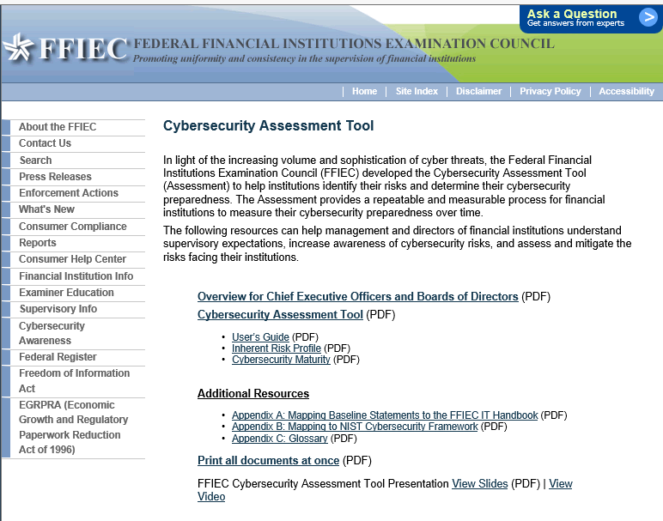
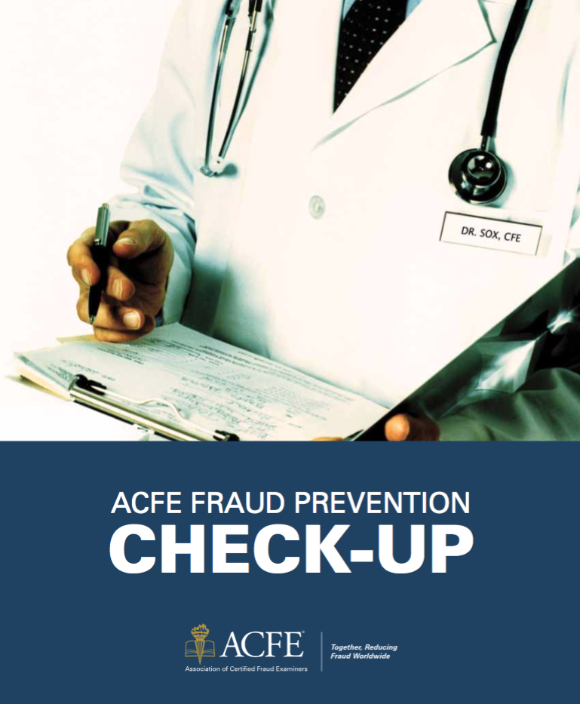
CYBER SECURITY RESOURCES

Slide 32
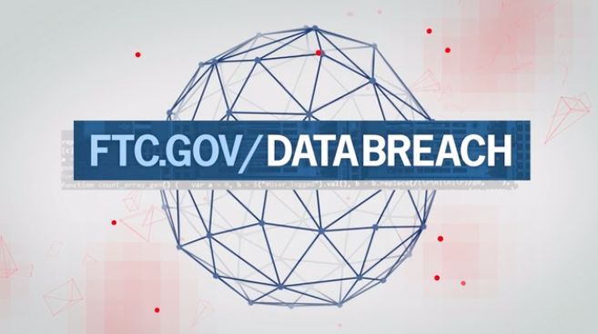
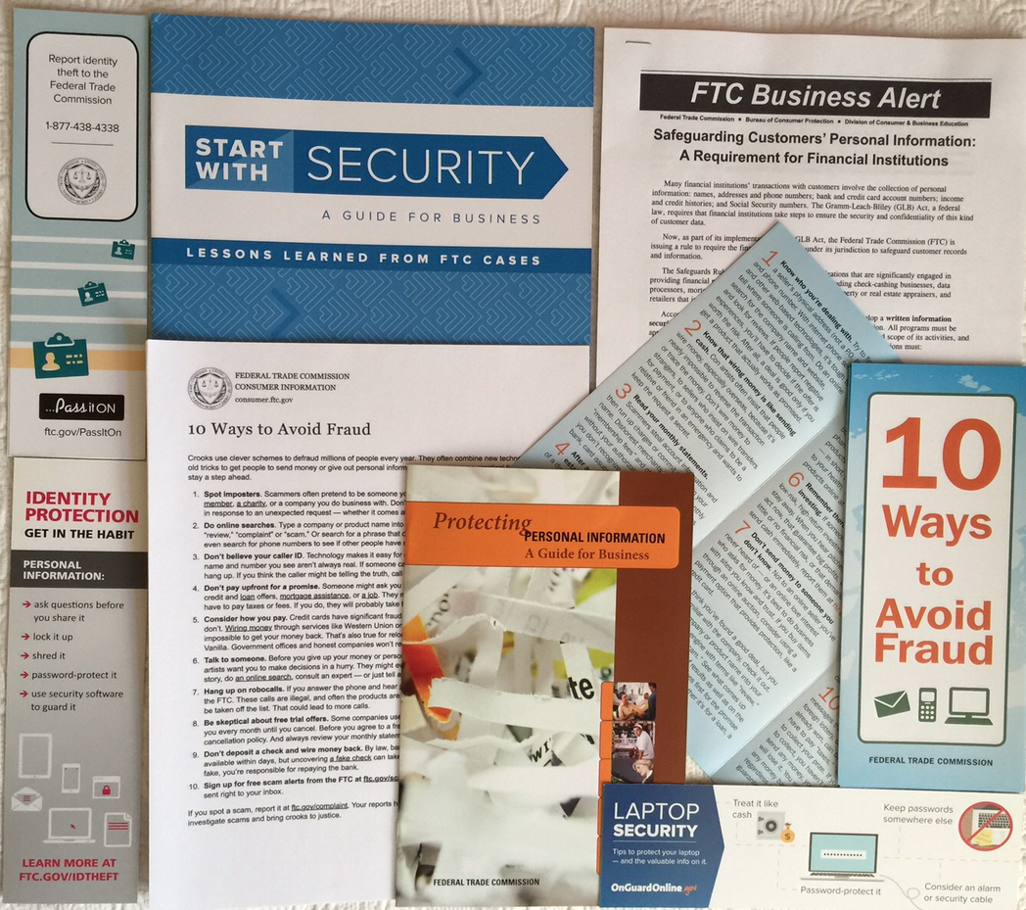
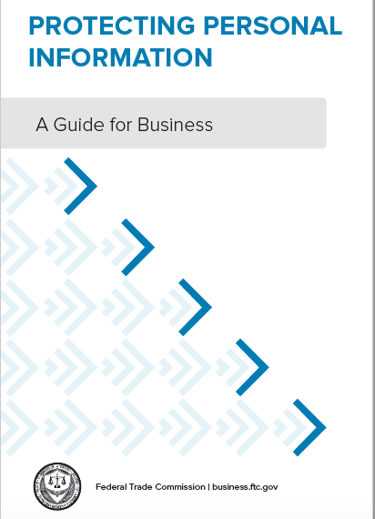
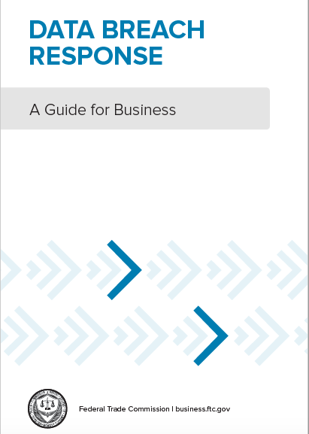
CYBER SECURITY RESOURCES

Slide 33
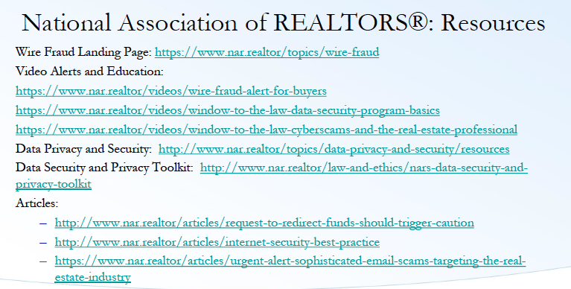

Slide 34
Next Up .....
A Hacking
Demonstration

