Slide 1
Bank Regulatory Update —
What is Top of Mind for the Regulators?

Slide 2
Speakers
Dawn E. Holstein
Acting Commissioner, WV Division of Financial Institutions
P: (304) 558-2294
dholstein@wvdob.org
Paul Reynolds
Of Counsel, Dinsmore & Shohl LLP Cincinnati, OH
P: (513) 977-8456
paul.reynolds@dinsmore.com
Dave Thomas
Partner, Dinsmore & Shohl LLP
Morgantown, WV
P: (304) 225-1422
david.thomas@dinsmore.com
Christian Gonzalez
Partner, Dinsmore & Shohl LLP Columbus, OH
P: (614) 628-6921
christian.gonzalez@dinsmore.com

Slide 3
Summary
Introductions / Status of Regulatory Environment - Dave Thomas
BSA Compliance & Cybersecurity/FinTech - Dawn Holstein
Board Governance/Oversight - Paul Reynolds
Assessing Risk Management Practices: Guidance and Supervisory Expectations - Christian Gonzalez
Question and Answers/General Panel Discussion

Slide 4
Overview / Status of Regulatory Environment
Dave Thomas

Slide 5
Timeline of Major Banking Regulation
The Great Depression
National Bank Act
The Great Recession
1933
2010
1913
1863/1864
1929
2008
Federal Reserve is established
Banking Act of 1933 (Glass-Steagall Act)
Dodd-Frank

Slide 6
Page Count of Major Banking Acts

Slide 7
Bank Regulation in Recent History
Last 25 Years
1991: Federal Deposit Insurance Corp. Improvement Act
1999: Gramm-Leach-Bliley Act
2010: Dodd-Frank
Twenty-five years ago, if you had taken all of the laws and regulations that applied to banks and stacked them on the floor, they would have stood about a foot high. Today, that same pile would be about three feet high. Bank Director Magazine – April 15, 2016

Slide 8
Bank Regulation Riddle
Question: What is 20 times taller than the Statute of Liberty, 15 times longer than “Moby Dick” and would take the average reader more than a month to read, even if you hunkered down with it for 40 hours a week?
Answer: The paper trail formed by Dodd Frank
-Wall Street Journal – May 2, 2011

Slide 9
Bank Act of 1933 – a/k/a “Glass-Steagall Act”
37 Pages
Adopted to stabilize financial industry after the Great Depression
Created FDIC insurance
Separated commercial banks and investment banks
Repealed in 1999 under GLB
Topic in recent presidential debates (some suggest repeal lead to Great Recession)
Established Reporting Requirements
Credited with keeping relative financial stability from 1930s to 1980s

Slide 10
Dodd-Frank
Most significant banking regulation since the 1933 Bank Act; 849 pages
Created new agencies – most notably the CFPB
$605.9 million Annual Budget
1,529 Employees
More strict regulatory capital requirements
Implemented changes to corporate governance and executive compensation practices
Incorporated the Volcker Rule
Effected significant changes in the securitization market
Over 400 new rules and mandates
Over 22,000 pages of regulatory content since the law went into effect — equivalent to 34 copies of Moby Dick

Slide 11
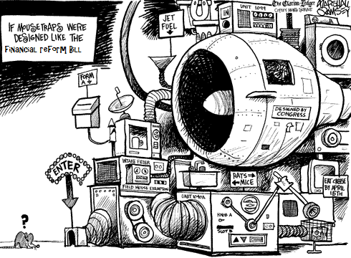

Slide 12
6th Anniversary of Dodd-Frank (July 21, 2016)
Enacted over 6 years ago, but not all mandates implemented
267 of 390 total required rulemakings have been met with finalized rules.
Rules have been proposed that would meet 40 more.
Rules have not yet been proposed to meet 83 rulemaking requirements, 33 of which have had deadlines already pass
In just the first quarter of 2016:
69 new regulatory changes have occurred totaling 1,569 pages

Slide 13
Dinsmore Bank Regulation Updater tool
Tool developed to track major Dodd-Frank mandates/rules
Provides short summaries and links to actual rules
Started out as 13 pages in 2011 and has grown to 88 pages (will soon be over 100 pages)
Currently available as an interactive PDF file
http://f.datasrvr.com/fr1/516/82031/Dodd-Frank-BRU_06152016.pdf

Slide 14
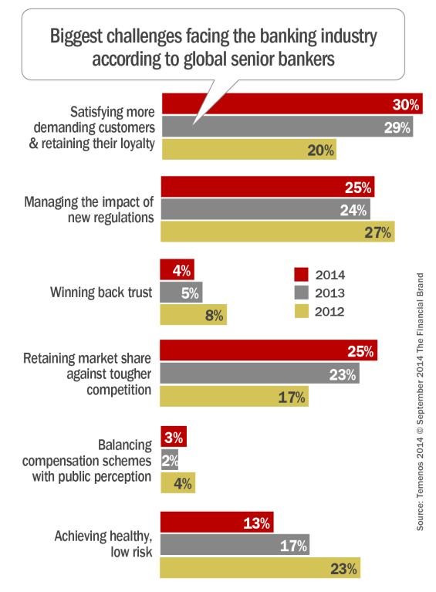

Slide 15
BSA Compliance & Cybersecurity/FinTech
Dawn Holstein

Slide 16
BANK SECRECY ACT
The Bank Secrecy Act (BSA) was created in 1970 to assist in criminal, tax, and regulatory investigations.
The Financial Crimes Enforcement Network (FinCEN) is responsible for compliance.
BSA compliance is required for all financial institutions, including banks.

Slide 17
BANK SECRECY ACT PROGRAM
System of Internal Controls
Independent Review
BSA Officer
Training; and
Customer Identification Program

Slide 18
SYSTEM OF INTERNAL CONTROLS
Appropriate policies, procedures, and processes are in place to promote compliance with bank secrecy and related regulations.
Inform the board of directors and senior management of SARs filed and corrective action taken.
Identify a person or persons responsible for BSA/AML compliance.
Identify reportable transactions and accurately file all required reports. (i.e. SARs and CTRs)

Slide 19
INDEPENDENT TESTING
Independent testing (audit) should be conducted by the internal audit department, outside auditors, consultants, or other qualified independent parties.
While the frequency of audit is not specifically defined in any statute, a sound practice is for the bank to conduct independent testing generally every 12 to 18 months, commensurate with the BSA/AML risk profile of the bank.

Slide 20
BANK SECRECY ACT OFFICER
Must be designated by the Board of Directors;
Must be qualified;
Must have sufficient authority, knowledge, and resources; and
Is responsible for ensuring overall BSA compliance.

Slide 21
BSA TRAINING
Appropriate personnel must be trained in applicable aspects of the BSA regulations.
Training should include regulatory requirements and the bank’s internal BSA/AML policies, procedures, and processes.
Training should be ongoing and incorporate current developments and changes to the BSA and related regulations.
Frequency of training.

Slide 22
ENFORCEMENT ACTIONS
Enforcement Actions can be issued for BSA/AML and OFAC program deficiencies.
Formal enforcement actions for BSA are mandated when: entire program is deficient, or repeat problems indicate management has failed to take corrective action in a timely and cohesive manner.
Depending on the nature and duration of deficiencies, the bank may be subject to Civil Money Penalties.

Slide 23
FAILURE TO FILE A SAR
Section 353.2(a)(4)(ii) of the FDIC Rules and Regulations, requires, in part, that a financial institution must file a SAR for transactions aggregating $5,000 or more, if designed to evade any BSA regulations.

Slide 24
FAILURE TO FILE A TIMELY SAR
Section 353.3(b) of the FDIC Rules and Regulations requires, in part, a bank shall file the SAR no later than 30 calendar days after the date of initial detection of facts that may constitute a basis for filing a SAR.

Slide 25
LACK OF INDEPENDENT TESTING OF BSA COMPLIANCE
Section 326.8(c)(2) of the FDIC Rules and Regulations requires that the written BSA compliance program provides for independent testing for compliance.

Slide 26
FAILURE TO NOTIFY BOARD OF SARS FILED
Section 353.3(f) of the FDIC Rules and Regulations requires management of a financial institution to notify its Board of Directors, or a committee thereof, of any report filed pursuant to this Section.

Slide 27
BSA MODEL VALIDATION
Management should have the AML manager transaction monitoring system validated independently by a qualified third party to ensure the rules, filters, and parameters are appropriate and accurate to capture all transaction activity.

Slide 28
BSA RISK ASSESSMENT
The BSA risk assessment should capture all relevant customers and entities.
The BSA risk assessment should include detailed analysis of statistical data regarding each product or service category.
All controls in place to mitigate risks associated with each product or service category should be identified clearly in the risk assessment.
The BSA risk assessment should address trust customers and activities.

Slide 29
CUSTOMER IDENTIFICATION PROGRAM
Section 1010.312 of the Treasury Department’s BSA regulation requires documentation of the form of identification used for the business entity listed on line 20 of the CTR form.

Slide 30
CUSTOMER IDENTIFICATION PROGRAM
Section 1020.220 of the Treasury Department’s BSA regulation specifies the minimum information that a financial institution must obtain from a customer prior to opening an account.
The regulation states that a physical address must be collected and a P.O. Box may not be used as the physical address.

Slide 31
INSIDER INVOLVED IN SUSPICIOUS ACTIVITY
Employee should be placed on the bank’s high-risk customer list.
Account activity should be monitored quarterly in accordance with the procedures of all other high-risk customers.
SARs should be filed on subject employee as appropriate.

Slide 32
Cybersecurity - Best Practices

Slide 33
The Cybersecurity Assessment Tool
Does not replace anything - provides a different vantage point
Not a one size approach
Provides FIs a way to evaluate Information Security Program
http://www.ffiec.gov/cyberassessmenttool.htm

Slide 34
THE PERSISTENT THREAT OF INTERNET ATTACKS
IS A SOCIETAL ISSUE FACING ALL INDUSTRIES ….
ONCE LARGELY CONSIDERED AN IT PROBLEM,
THE RISE IN FREQUENCY AND SOPHISTICATION
OF CYBER-ATTACKS NOW REQUIRES A SHIFT IN
THINKING ……A BANK’S CYBERSECURITY
RISK IS NOT SIMPLY AN IT ISSUE, BUT A
CEO AND BOARD OF DIRECTORS ISSUE.
CSBS

Slide 35
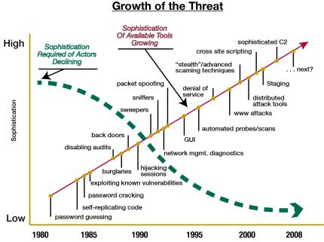
CYBERSECURITY CULTURE

Slide 36
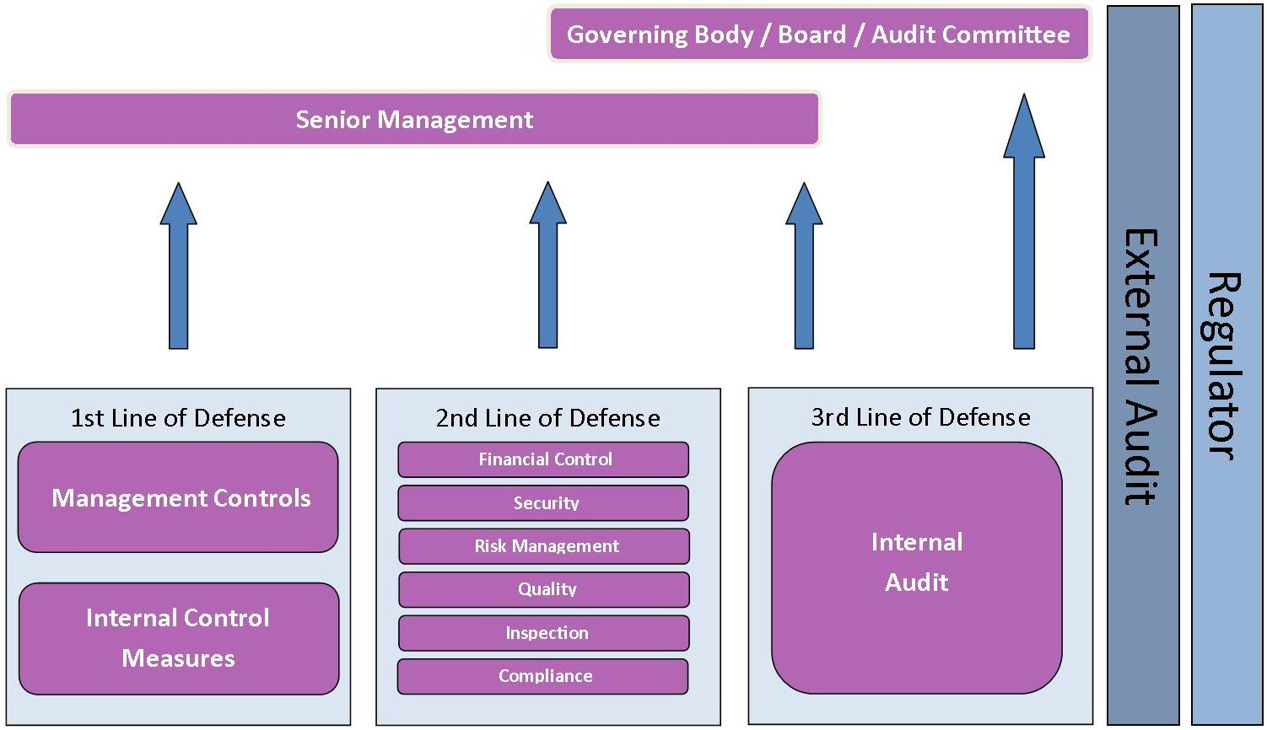
LINES OF CYBERGOVERNANCE

Slide 37
ENGAGE management in establishing the institution’s vision, risk appetite, and overall strategic direction.
APPROVE plans to use the ASSESSMENT
REVIEW management’s analysis of the results

Slide 38
Review management’s determination of whether the institution’s cybersecurity preparedness is aligned with its risks
Review and approval of plans to address any risk management or control weakness
Review the results of management’s ongoing monitoring of the institution's exposure to and preparedness for cyber threats

Slide 39
CYBER RISK MANAGEMENT PROCESS
“Bank CEOs should strive to create and implement an effective and resilient risk–management process to enable proper oversight and to ensure that you are effectively managing cybersecurity risks. Key elements of a risk–management process should include the initial assessment of new threats; identifying and prioritizing gaps in current policies, procedures, and controls; and updating and testing policies, procedures, and controls as necessary.”-CSBS

Slide 40
EXECUTIVE MANAGEMENT
Commit to developing a corporate cybersecurity culture
Cybersecurity should be on the agenda at least monthly
Review how much time you spend valuing cybersecurity
Instill a culture to make certain ALL employees have buy-in for brand protection and risk reduction
Ensure cybersecurity is included in on-going training programs
Implement enhanced management oversight practices
Build in and demonstrate fluidity in risk assessment and incident response processes
Regularly monitor various channels for threat updates and effectively communicate them to the organization
Carry the message beyond the bank
Community outreach will enhance customer awareness and strengthen relationships

Slide 41
INDUSTRY AND REGULATORY COLLABORATION
Information sharing is a critical aspect in improving cybersecurity
Obtaining information expeditiously will aid in the risk identification and mitigation process
Government sector can present from a global perspective
Private sector can aid the government sector in understanding the threat environment
Venues for sharing are growing
FS-ISAC
INFRAGARD
Multi-State Information Sharing and Analysis Center
US-CERT
U.S. Secret Service Electronic Crimes Task Force (ECTF)
ISACA
Krebs on Security
Local trade associations
FFIEC’s Cyber Security Website

Slide 42
QUESTIONS TO ASK YOURSELF
Have you defined a culture that emphasizes cybersecurity?
If yes-how do you further strengthen and sustain?
If no-where do you begin?
What will you place on the next Board and committee agenda?
What steps can you take immediately to improve risk management of cybersecurity?
What can you do as executive management to enhance cybersecurity awareness throughout the institution?
How are you going to keep the momentum going?

Slide 43
Key Takeaways
The tone must be set at the top. Executive Management should develop a cybersecurity strategy and give it broad staff and Board visibility.
Cybersecurity can no longer be seen as just an ‘IT’ problem. This is a risk management problem.
Cybersecurity threats continue to evolve. Management’s risk management processes must continue to evolve. The examination process will also continue to evolve.

Slide 44
FinTech

Slide 45
FinTech
Financial technology, also known as FinTech, is an economic industry composed of companies that use technology to make financial services more efficient.
Start-ups with few investors and one or two big ideas often can sometimes move faster than larger and more established organizations. They can focus their energy and resources on a single opportunity. Start-ups do not have legacy technology systems or large brick-and-mortar infrastructures that can be costly to maintain or change. Nonbank innovators also may have specialized technical knowledge, experience, and skills with respect to emerging technology and trends.

Slide 46
“Responsible Innovation”
Innovation is not free from risk, but when managed appropriately, risk should not impede progress. Effective risk management is essential to responsible innovation. Banks and regulators must strike the right balance between risk and innovation.

Slide 47
Innovation vs Security
FinTech companies often face doubts from financial regulators. Data security is another issue regulators are concerned about because of the threat of hacking as well as the need to protect sensitive consumer and corporate financial data.
The Office of the Comptroller of the Currency is seeking to create a regulatory sandbox that it hopes will allow Fintechs and banks to experiment on innovations to the financial system.

Slide 48
Fintech firms have lobbied for the OCC to create a limited-purpose charter that would allow firms to follow one set of federal rules instead of various state regulations, but not subject them to the same amount of regulation as full-fledged financial institutions.

Slide 49
The OCC released a white paper in March 2016 – Supporting Responsible Innovation in the Federal Banking System.
OCC definition of “responsible innovation” :
The use of new or improved financial products, services, and processes to meet the evolving needs of consumers, businesses, and communities in a manner that is consistent with sound risk management and is aligned with the bank's overall business strategy.

Slide 50
This definition recognizes the importance of banks’ receptivity to new ideas, products, and operational approaches to succeed in meeting the needs of consumers, businesses, and communities in the rapidly changing financial environment.

Slide 51
The definition also emphasizes effective risk management and corporate governance. As we learned in the financial crisis, not all innovation is positive. The financial crisis was fueled in part by innovations such as option adjustable rate mortgages, structured investment vehicles, and a variety of complex securities that ultimately resulted in significant losses for financial institutions and their customers and threatened the entire financial system. The OCC will support innovation that is consistent with safety and soundness, compliant with applicable laws and regulations, and protective of consumers’ rights.

Slide 52
Guiding Principles for the OCC’s Approach to Responsible Innovation
The agency has formulated eight principles to guide the development of its framework for understanding and evaluating innovative products, services, and processes that OCC-regulated banks may offer or perform. These principles call for the OCC to:

Slide 53
1. Support responsible innovation.
2. Foster an internal culture receptive to responsible innovation.
3. Leverage agency experience and expertise.
4. Encourage responsible innovation that provides fair access to financial services and fair treatment of consumers.
5. Further safe and sound operations through effective risk management.
6. Encourage banks of all sizes to integrate responsible innovation into their strategic planning.
7. Promote ongoing dialogue through formal outreach.
8. Collaborate with other regulators.

Slide 54
CONTACT INFORMATION
Dawn E Holstein, Acting Commissioner
West Virginia Division of Financial Institutions
Charleston, West Virginia
(304) 558-2294
dholstein@wvdob.org

Slide 55
Board Governance/Oversight
Paul Reynolds

Slide 56
Definition of Corporate Governance
Corporate governance is the framework by which a company’s board of directors and senior management establishes and pursues objectives while providing effective separation of ownership and control. It includes the establishment and maintenance of independent validation mechanisms within the organization that ensure the reliability of the system of controls used by the board of directors to monitor compliance with the adopted strategies and risk tolerance.
Taken from “An Assessment of the Corporate Governance Practices of Fifth Federal Reserve District Banking Institutions” issued by the Federal Reserve Bank of Richmond, June 30, 2004 (emphasis added).

Slide 57
Eleven Elements That Determine Proper Board Supervision
Director Compensation
Board Meetings
Board Member Qualifications
Board Charters
Board Committees
Board Member Assessments
Board Minutes
MIS
Audit Committee Operation (Risk)
Director Education
Governance Committees

Slide 58
Largest Contributors to a Dysfunctional Board
Too much time spent on compliance and other backward looking reviews at the expense of strategy
Lack of trust between Board and CEO
Weak or non-existent CEO succession plan
Lack of Board succession planning
Disruptive or disengaged directors
Poor decision making processes
Lack of a direct channel to shareholders
Too much Board information and material
Source: Spencer Stuart – 2016 Point of View

Slide 59
Evolving Areas of Regulatory Supervision
Capital planning and adequacy
Liquidity
Interest rate risk
Board expertise
Education
Oversight of business model and strategy
Cybersecurity

Slide 60
Overarching Governance Challenges and Regulatory Expectations
Subjective requirements
Separation of board and management roles
Minutes and record keeping
Interest and focus of shareholders and regulators not necessarily aligned

Slide 61
Board Composition and Board Governance Evolution
Separation of titles
Necessary (and expected) skills
Reports and information

Slide 62
Assessing Risk Management Practices: Guidance and Supervisory Expectations
New Guidance Issued by Federal Reserve for Institutions under $50 billion
Impact on Risk Management Ratings
Christian Gonzalez

Slide 63
Assessing Risk Management Practices
Evaluation of Risk Management
FRB evaluates the overall effectiveness of a covered institution's risk management based on whether the covered institution adequately identifies, measures, monitors and controls its risks
Entire Spectrum of Risk that should be covered:
Credit Risk
Market Risk
Liquidity Risk
Operation Risk
Compliance Risk
Legal Risk
“One Size Fits All” Risk Management approach doesn’t work.

Slide 64
Evaluation of Risk Management (cont’)
Elements of Sound Risk Management System:
Board and senior management oversight
Policies, procedures and limits
Risk monitoring and management information systems
internal controls

Slide 65
Element 1: Board and Senior Management Oversight
Board of Directors
The board of directors should approve the overall business strategies and significant policies relating to risk, including established risk tolerance.
Senior Management
Senior management is responsible for implementing the strategies set by the board of directors in a manner that controls risks and complies with applicable regulatory and supervisory requirements.
Supervisory Expectations

Slide 66
Element 2: Policies, Procedures and Limits
Ensure you maintain, update and audit all policies – If it's not in writing well…..
Policies, procedures and/or limits should:
identify, measure, monitor and control the risks
Address significant activities and material areas of risks
be consistent with the stated strategy and risk profile
establish accountability and lines of authority across activities
provide for review and approval of new or materially modified business lines, products and activities to identify, measure, monitor and control the associated risks
provide for review and approval of new or materially modified business lines, products and activities to identify, measure, monitor and control the associated risks
be modified when necessary to account for significant changes in activities or business

Slide 67
Element 3: Risk Monitoring and Management Information System
Banks need to have risk monitoring and management information systems in place that provide the board of directors and senior management timely and clear understanding business activities and risks
Supervisory Expectations

Slide 68
Element 4: Internal Controls
Effective internal controls:
promote reliable financial and regulatory reporting to safeguard assets
ensure compliance with relevant regulatory and supervisory requirements and internal policies
Key to effective internal controls
Board and Management responsible for implementation of controls
The organizational structure should:
(1) establish clear lines of authority and responsibility for risk management and for monitoring adherence to internal policies and procedures as well as adequate segregation of duties and
(2) reflect actual operating practices and management responsibilities and authority over particular business lines and activities
Internal audit or other control functions, such as loan review and compliance, should provide for independence and objectivity
Financial, operational, risk management and regulatory reports should be reliable, accurate and timely and, where applicable, material exceptions should be noted and promptly investigated or remediated
Supervisory Expectations

