Slide 1
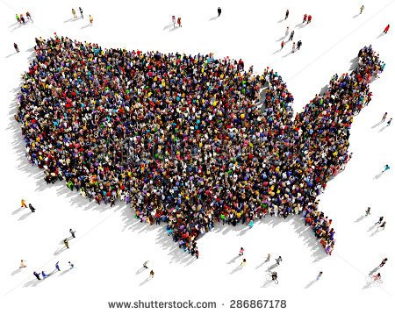
Fifty States, One Court:
Multi-District Litigation (MDL) Best Practices and Efficient Management of Centralized Litigation

Slide 2
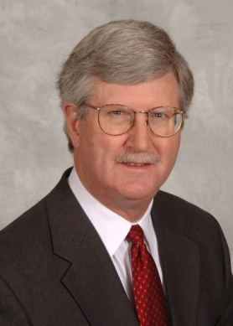
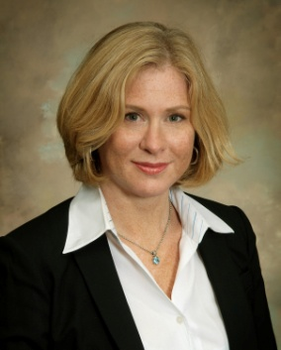
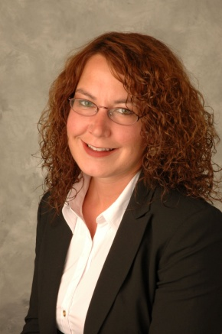
Moderator: Sharon Stier
Michael D. Eagen
Of Counsel | Cincinnati, OH
P: (513) 977-8578
michael.eagen@dinsmore.com
Access Bio Here
Education
J.D., University of Michigan Law School
B.A., College of the Holy Cross
Admitted: OH, KY
Jill F. Endicott
Partner | Louisville, KY
P: (502) 581-8057
jill.endicott@dinsmore.com
Access Bio Here
Education
J.D., George Washington University Law School
B.A., University of Pennsylvania
Admitted: KY
Katrina R. Atkins
Associate | Cincinnati, OH
P: (513) 977-8205
katrina.atkins@dinsmore.com
Access Bio Here
Education
J.D., Northern Kentucky University, Chase College of Law
B.S.W., University of Cincinnati
Admitted: OH

Slide 3
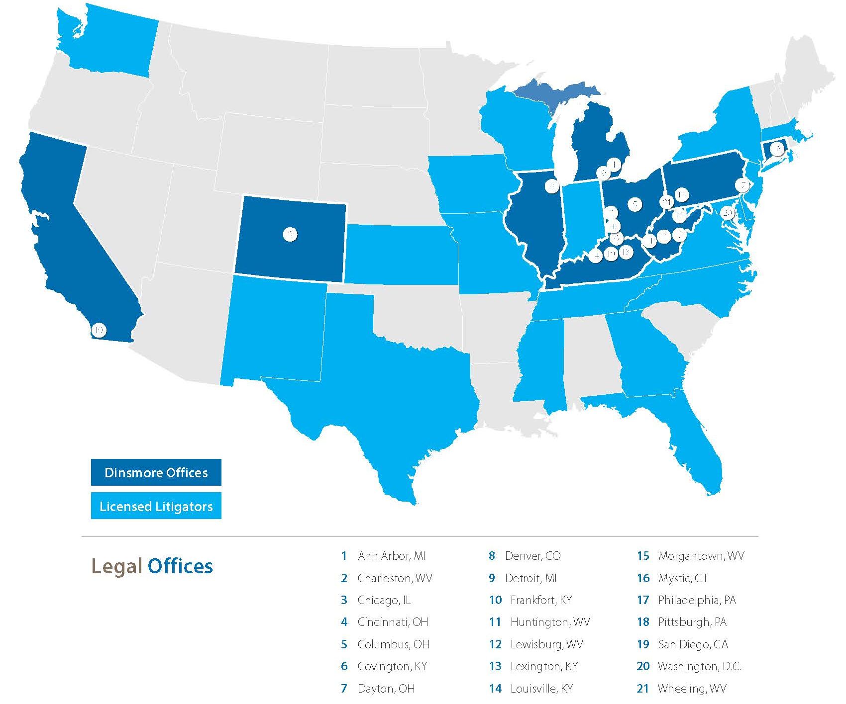

Slide 4
Criteria for Certification
Civil actions pending in more than one Federal District Court with common questions of fact based on
(1) convenience;
(2) just and efficient conduct of cases;
PURPOSE is to avoid duplication of discovery and trial preparation in multiple Federal District Courts.

Slide 5
Contrast to Class Action
Start Differently: Panel Certification vs. Motion to Certify to Trial Judge
Discovery Similar: Committees/Case Management Procedure Orders/ Consolidated in one Court
End Differently: Settlement or Remand (Lexecon Case) vs. Court Approved Resolution or Trials

Slide 6
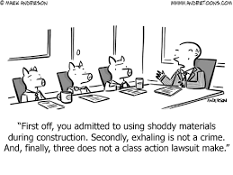
Pros and Cons of Certification
Con:
Rings the dinner bell
Makes it easy for less talented/funded Plaintiff’s counsel
Allows better talented/well funded Plaintiff’s counsel to control discovery
Pro:
Cost savings
Single lead defense counsel in control (Reduce inconsistency)
Insured/client deals with limited depositions and document requests

Slide 7
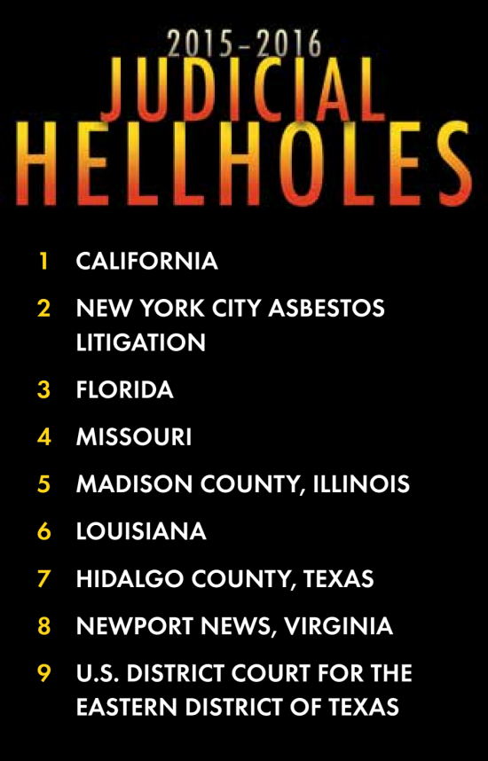
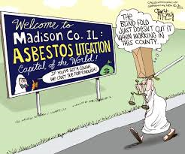
Transferee Jurisdiction and Judge
Suggestions considered from litigants
Selection made by the Panel
Selection may or may not be based on
(1) Familiarity with the litigation (already have cases)
(2) Prior experience as transferee Judge
(3) Room on docket

Slide 8
Settlement
Requires creativity and resourcefulness like any mass tort settlement
Use of “sequential” partial settlements
Use of court-appointed “special settlement master”

Slide 9
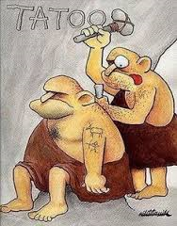
Case Management Orders
You Must Consider these to be written in STONE
Initial CMOs/PPOs Will Govern:
Rules for complaints and answers
Which attorneys will lead the litigation
Scheduling and pace of the litigation
Discovery timing and parameters
Opportunity to:
Obtain as much information as possible from plaintiffs
Control cost of the litigation

Slide 10
Case Management Orders: Complaints and Answers
Most Important Takeaway from CMO Discussion:
Single
PlaIntiff
Complaints
Only!

Slide 11
Case Management Orders: Complaints and Answers
Direct Filing v. Indirect Filing
Direct Filing | Indirect Filing
Allows plaintiffs’ counsel file the claims of plaintiffs from across the country without hiring local counsel or pro hac admission Defendants save cost of removal | Forces plaintiffs to hire local counsel or pro hac into the local federal court Defendants incur extra cost of removal
Specify No Lexecon Waiver!

Slide 12
Case Management Orders: Complaints and Answers
Allow Master Complaints?
Pros of Master Complaints | Cons of Master Complaints
Master Answer – Eliminates need to respond individually to complaints, which results in: Cost reduction Loss of default opportunity More Information – Short form complaints are typically check-box format. Opportunity to define contents: Date and place of purchase Date and place of injury Product identification information | Makes filing process more efficient for plaintiffs, which results in more claims being filed.

Slide 13
Case Management Orders: Discovery
Discovery may only be taken pursuant to the Case Management Orders
Only Lead and Liaison Counsel may serve discovery
Document repository

Slide 14
Case Management Orders: Plaintiff’s Fact Sheet
Be comprehensive - This may be all the written discovery provided by plaintiffs.
Understand medical aspects of product, injury and other causes for the same injury.
Provide Input
Have fact sheets from other MDL’s been reviewed?
Be specific, Use checklists
Incorporate Authorizations
Declaration

Slide 15
Case Management Orders: Plaintiff’s Fact Sheet
Be Sure to Include Questions Regarding:
Social Media
Bankruptcy
Insurance information
Was the product recommended by a medical professional
Did a medical professional (or any person) ever link the injury to the product? When?
Production of Documents and Things

Slide 16
Coordination Order
One bite at the apple on discovery
Be specific about what types of discovery are covered
How will newly discovered information be handled?

Slide 17
Later Case Management Orders
Product Identification
Failure to Comply with CMO’s
Lone-Pine Orders
IME’s
Expert Reports
Proof of Use
Proof of Causation

Slide 18
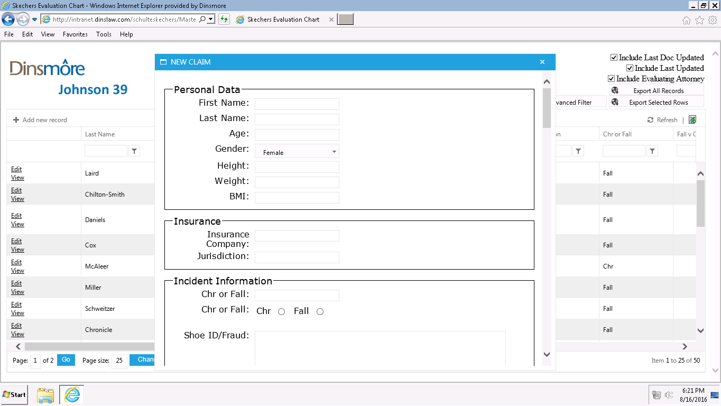
Case Evaluation: Multifunctional Data Systems
Store plaintiff data and analysis in a format that can grow with the litigation
Searchable
Capable of producing a report

Slide 19
Case Evaluation: Extractable Data

Slide 20
Case Evaluation: From Data to Report

Slide 21
Litigation-Wide Issues
National counsel
Related proceedings in other courts and before regulatory agencies
Pleadings and motion practice
E-discovery, document production, and written discovery
Company witnesses and other fact witnesses
Expert witnesses
Cooperation among carriers

Slide 22
Challenges of the Claim Professional
Multiple insurers due to various dates of loss-importance of coordination and cost share agreement
Working closely with defense counsel on strategic decisions sometimes adverse to your insured’s desires
Decision regarding early resolution v. costly discovery

Slide 23
Lessons Learned
Retain good coverage counsel to assist when there are coverage issues
Retain defense counsel experienced with MDL
MDL’s are expensive to defend and easy for plaintiff lawyers to add clients
Ongoing communication with insured, defense counsel and other insurers
Insured’s role in settlement demands-resolve all coverage issues at same time

Slide 24
Michael D. Eagen
Of Counsel | Cincinnati, OH
P: (513) 977-8578
michael.eagen@dinsmore.com
Jill F. Endicott
Partner | Louisville, KY
P: (502) 581-8057
jill.endicott@dinsmore.com
Katrina R. Atkins
Associate | Cincinnati, OH
P: (513) 977-8205
katrina.atkins@dinsmore.com

