Slide 1


Cyber-Security and Supply Chain Risk Management
Joel deJesus
Dinsmore & Shohl LLP
Washington, DC
joel.dejesus@dinsmore.com
For the American Council of Engineering Companies, May 2017

Slide 2

“ACEC has met the standards and requirements of the Registered Continuing Education Program. Credit earned on completion of this program will be reported to RCEP at RCEP.net. A certificate of completion will be issued to each participant. As such, it does not include content that may be deemed or construed to be an approval or endorsement by the RCEP.”

Slide 3
COPYRIGHT MATERIALS
This educational activity is protected by U.S. and International copyright laws. Reproduction, distribution, display and use of the educational activity without written permission of the presenter is prohibited.
Joel deJesus
Partner
Dinsmore & Shohl LLP

Slide 4
Purpose and Learning Objectives
Examine recent actions at FERC, NERC and NIST
Look at what is motivating these trends
How these trends will affect the relationship between engineer firms and their clients

Slide 5

The electric grid “faces physical or online attacks approximately ‘once every four days’”
Notes:
So cybersecurity in the electric industry has been a hot topic for some time, and given the cyber attacks in the Ukraine in late 2015, the topic has gotten even hotter.
I’ll be talking about one particular ly new development in this area, and that is a focus on cybersecurity as it relates to the supply chain. As Engineering Companies, many of you figure prominently in the supply chain of electric utilities, and developments in supply chain risk management for electric utilities will likely affect you all and your customer relationships, how you go about designing and integrating hardware and software products, and ongoing obligations to your customers over the life of your products and services
There have been alot of statistics, but this one is based on a USA Today report based on a DOE report that over 4 years there have been 320 attacks
-What constitutes an attack?
-What gets reported?

Slide 6


Notes:
Let’s jump in. Most of the activity in supply chain risk management relates to these two organizations
Just to understand the lay of the land, I’d like to do a quick Poll
(1) How many of you are familiar with the reliability standards promulgated by NERC and adopted by FERC?
(2) How many of you are familiar the Critical Infrastructure Protection (or “CIP”) family of standards?
As a result of the great Northeast Blackout in 2003, Congress in EPAct 2005 directed FERC to establish an “Electric Reliablity Organization” to promulgate and enforce mandatory reliability standards
FERC chose NERC, and NERC issued its first set of reliability standards in 2006.
For the most part the reliability standards, merely codified existing practices.
But in the area of cybersecurity, NERC’s Critical Infrastructure Protection standards were written fairly recently. And without decades of operationalization, NERC, FERC and the industry have struggled a bit with writing, and applying the CIP standards.
They have been revised about 7 or 8 times in the past 10 years.

Slide 7
CIP Reliability Standards - Cybersecurity
CIP-002 –Asset Identification/Categorization
CIP-003 – Security Management Controls
CIP-004 – Personnel & Training
CIP-005 – Electronic Security Perimeters
CIP-006 – Physical Security
CIP-007 – Systems Security Management
CIP-008 – Incident Reporting and Response
CIP-009 – Recovery Plans
CIP-010 – Configuration Change Management
CIP-011 - Information Protection
Notes:
These are the areas that NERC currently regulates
They for the most part focus on utility operations
BA, DP, GOP, GO, IC/IA, RC, TO, TOP
BES Cyber Systems – which are basically OT systems that could affect the bulk electric system reliability within 15 minutes of them being compromised
NOTE THAT CIP-004 requirements did apply to vendors who have either unescorted physical access or electronic access to a BES Cyber System.

Slide 8

“Separately, we are concerned that changes in the bulk electric system cyber threat landscape, identified through recent malware campaigns targeting supply chain vendors, have highlighted a gap in the protections under the CIP Reliability Standards. These malware campaigns represent a new type of threat to the reliability of the bulk electric system where malicious code can infect the software of industrial control systems used by responsible entities.”
Revised Critical Infrastructure Protection Reliability Standards, 80 Fed. Reg. 43,354 (July 22, 2015), 152 FERC ¶ 61,054 (2015)
Notes:
That focus on utility operations changed dramatically in the course of reviewing proposed Version 6 of the CIP standards.
As reflected in this quote, in addition to asking for comment on the usual questions of whether a standard was written in a way that would be enforceable, FERC solicited questions about cyber risks that are involved in the supply chain.

Slide 9

NOPR – Identified Risks
Vector for malware
Poor design/production
Counterfeits
Product tampering
Theft
Unauthorized access/control
“The Unknown”
Notes:
In the NOPR, FERC raised more supply chain concerns than simply malware issues.
They referenced hardware and software products that were developed without placing due importance on security

Slide 10

Supply Chain Risk Management
- What is Really at Stake?
ICS-ALERT-14-176-02A – ICS focused malware campaign
Software installers were infected with Havex Trojan
3 known ICS vendors
Indicators of compromise to critical infrastructure owners and operators
Notes:
Issued June 27, 2014, updated July 1, 2014
The Havex trojan is a form of malware that is used by hackers to gather information about a system (access controls, vulnerabilities) and report that information back to the hackers.

Slide 11
Supply Chain Risk Management
- What is Really at Stake?
ICS-ALERT-14-281-01E – Ongoing malware campaign compromising ICS
Ongoing since 2011
Variant of BlackEnergy malware (BE3)
Various vendors have been targeted (GE Cimplicity, Advantech/Broadwin WebAccess and Seimens WinCC)
2016 Update: BE3 was present in Ukraine Attack
Notes:
Issued December 10, 2014, updated December 9, 2016
This alert relates to the Black Energy virus
This virus allows for information sharing (like Havex), delivery of other malware, and remote control
The alert was originally issued in 2011
The alert was recently updated because the virus was found to be present in systems that were part of the Ukraine attack.

Slide 12
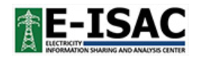
Supply Chain Risk Management
- What is Really at Stake?
E-ISAC, Analysis of the Cyber Attack on Ukrainian Power Grid
Spear Phishing/Theft of credentials
Used VPNs from business network to enter ICS network
Mitigation – Procurement/licensing of trusted hardware/software; network monitoring; strategic technology refresh
Notes:
(March 18, 2016)
Although the comments on the NOPR were skeptical that supply chain issues were a real risk to electric reliability, the cyber attack on the Ukraine Power Grid in December 2015, which occurred after FERC had received comments on the NOPR
And while the Ukraine incident couldn’t technically be considered a supply chain issue, elements of this multi layered “blended” attack showed the potential for a similar supply chain attack. This is especially true with respect to the use of malware for surveilance and theft of access credentials and the disruptive use of remote access and remote control of operating technology.
Moreover, by this report from NERC’s Electric –Information Sharing and Analysis Center, many of the mitigation measures recommended to counter a Ukraine style attack relate to the supply chain.

Slide 13

Order No. 829
On 7/21/2016, FERC directed NERC to develop a standard within one year
Four security objectives
Software integrity and authenticity
Vendor remote access
Information system planning
Vendor risk management and procurement controls
Notes:
Order 829 was really about the approval of the Version 6 CIP standards – FERC shoe-horned the supply chain issue in the NOPR
Objective 1: Software Integrity and Authenticity
Verify identity of software publisher; Verify integrity of software and patches prior to installation; Avoid “Watering Hole” Attack
Objective 2: Vendor Remote Access
Logging and controlling all third-party initiated remote access sessions; User initiated and machine-to-machine remote access; Theft of credentials and remote persistent connections were central to Ukraine Attack
Objective 3: Information System Planning
Include security considerations as part of IS planning; Document role of CIP Senior Manager; BlackEnergy Malware alert – “minimize network exposure for all control system devices/subsystems”; Ukraine incident – strategic technology refreshes
Objective 4: Vendor Risk Management and Procurement Controls
Verification of security concepts in future contracts; Security event notification and coordinated incident response; Personnel termination Vulnerability disclosures

Slide 14
Order No. 829 - What is Really Required?
Objective | Existing Standards | What’s Missing?
Software Integrity and Authenticity | CIP-007 R2 CIP-004 R3 | Secure transmittal of patches Validate patch integrity
Vendor Remote Access | CIP-005 R2 | Machine-to-machine logging Monitor/terminate sessions
Information System Planning | CIP-010 | Procurement controls
Vendor Risk Management and Procurement Controls | ? | Include security concepts in future contracts
Notes:
As I mentioned above, many of NERC’s standards already addressed aspects of supply chain issues, but this slide identifies the gaps that FERC sought to fill
CIP-007 R2 – patch management
CIP-004 R3 – Background checks (“personnel risk assessments”) even for vendors and contractors
CIP-005 R2 – Protections for remote access
CIP-010 – Change management

Slide 15
Project 2016-03
Standards Drafting Team – Southern Company, PJM, Georgia Transmission, Duke, IESO, SPP, SoCal Edison, Dominion, CPS, SRP, EKPC.
Standards Authorization Request – posted 10/20/2016-11/18/2016, accepted 12/14/2016
Technical Conference – 11/10/2016
First Draft of CIP-013-1 – posted 2/17/2017 - 3/6/2017, failed (<11% of the stakeholders supported it)
Notes:
Since last fall, NERC has undertaken an effort to start development of a supply chain risk management standard in response to FERC’s directive.
They convened a drafting team.
One of the things to notice on this list is that the team is comprised exclusively of utilities. On the one hand that makes sense, since they must buy the hardware and software used in the bulk electric system. But unlike other NERC standards which focus on utility operations, this standard will affect the utilities’ relationships with their suppliers, vendors, manufacturers, integrators, and there is no direct representation on the drafting team for those entities.
Nevertheless, I understand that the team has allowed participation by outside observers and ACEC have been active in the process as an observer. You’ll also note that NERC convened a technical conference to solicit views from entities outside the standards drafting.
Nevertheless, in March, NERC posted the first draft of the standard for ballot, and it only received a 11% vote. Although the draft not expected to pass on the first ballot, this is very low.

Slide 16
CIP-013-1: Comments on Draft 1
  Applicability to existing vs. future contracts
  Definition of “vendors”
  Applicability to low impact BES Cyber Assets
  Specificity of controls
  Applicability to access controls
  Periodic reevaluation of risks
  Overlap with existing standards
Notes:
Here is a list of reasons why the stakeholders voted no to the first draft.
Much if the concern had to do with scope (existing vs future contracts), and whether the standard was appropriately risk based
But it was apparent that underlying all of the comments was a general skepticism as to whether a supply chain risk management standard is really needed

Slide 17
CIP-013-1 Draft 2
R1 – Develop documented supply chain cybersecurity risk management plan.
  Applies only to high and medium impact BES Cyber Systems and only to future contracts
  Plan must address
    Cybersecurity risk during procurement and deployment of vendor products and services
    Notice and coordination of response to incidents and known vulnerabilities
    Coordinate remote and onsite access
Notes:
The drafting team is currently working on a second draft of the standard. Much of the changes are for the benefit of the utilities who will need to comply with the standard, but a number of changes also benefit suppliers.
-reduce scope to exclude low-impact BES cyber systems
- Requiring coordination to KNOWN vulnerabilities.

Slide 18
CIP-013-1 Draft 2
R2 – Implement supply chain cybersecurity risk management plan.
  No need to abrogate or renegotiate existing agreements
  Scope does not include substantive compliance with contract terms
R3 – CIP Senior Manager approval of plan every 15 calendar months
* * * * *
NOTE: Other provisions in Draft 1 dealing with software integrity and authenticity and with vendor initiated remote access (either user initiated or machine-to-machine) were deleted because those issues will be addressed in other standards.
Notes:
Requirement 2
No abrogation of existing contracts
Utilities are not held to ensuring the specific terms of their supply contracts match their supply chain risk management plan – it’s only important that you try.
SO UNDER THESE STANDARDS WHEN YOU ARE NEGOTIATING NEW CONTRACTS WITH UTILITIES, YOU ARE LIKELY TO ENCOUNTER UTILITIES WHO WILL STRICTLY ADHERE TO THEIR PLANS AND THOSE WHO MAY BE LESS STRICT.
CIP-010-3 – Verify Identity of software source and integrity of the software as part of the change management process
CIP-005-6 – monitor and disable vendor remote access sessions as part of remote access management

Slide 19
Next Steps for CIP-013-1
  Draft 2 has not yet been posted, but it is expected to be posted for a 45-day ballot and comment period from 4/30/2017 to 6/13/2017
  A final ballot will be conducted 6/21-30/2017
  Presentation to NERC Board of Trustees by 8/11/2017
  Filing with FERC by 9/27/2017
Notes:
There is a slight change in this schedule. The Revised Standard (which includes CIP-013-1, CIP-005-6 and CIP-010-3) was posted two days ago on May 2, and a ballot and comment period is open through June 15.
It’s hard to tell where Draft 2 will go, whether the stakeholders will like it enough to pass it. But here is the schedule from here on out. There is not much time for another round of balloting before NERC’s compliance deadline, and there is a risk that the NERC Board may need to act unilaterally under Rule 321 to comply with FERC’s directive (or it could seek an extension of time).
The other big question will be whether FERC believes that the standard goes far enough.
ASK IF ANYONE HAS QUESTIONS

Slide 20

Cybersecurity Framework
Notes:
POLL: How many folks are familiar with NIST’s Cybersecurity Framework?

Slide 21
How did NIST get involved?
Executive Order 13636: Improving Critical Infrastructure Cybersecurity (2/12/2013)
Sharing of cybersecurity threat information
NIST is tasked with development of a Cybersecurity Framework
  Collaboration with government and industry stakeholders
  Voluntary
  Goes beyond electric industry
Version 1.0 was published on February 12, 2014
NIST received legislative authority to continue updating the Framework under the Cybersecurity Enhancement Act of 2014 (P.L. 113-274)
Notes:
In 2013 President Obama issued EO 16636
THIS APPLIES TO ALL CRITICAL INFRASTRUCTURE SECTORS Under Presidential Policy Directive 21 (PPD-21) 16 sectors
Chemical
Commercial facilities
Communications
Critical manufacturing
Dams
Defense Industrial Base
Emergency Services
Energy
Financial Services
Food and Agriculture
Government facilities
Healthcare and Public Health
Information Technology
Nuclear
Transportation
Water and Waste

Slide 22
Framework 1.0
Common taxonomy to describe cybersecurity posture, target state, and opportunities for improvement
  Core Functions– identify, protect, detect, respond, recover
  Tiers – partial, risk informed, repeatable, adaptive
  Profile – current, target
A copy of the framework can be found here: https://www.nist.gov/cyberframework
Notes:
The Framework is a fairly long document, but in a nutshell, it is a basic way of describing and measuring cybersecurity preparedness at any given time. The framework would also allow for the development of a target state to facilitiate planning for improvements.
This is critical, because there was a broad concern that EO 13636 might lead to mandatory requirements. That concern was avoided in favor of this open architecture approach.
alignment of core functions with business requirements, risk tolerance and resources

Slide 23
Need for updating
NIST CYBER SECURITY FRAMEWORK FAQs
51. What changes are included in the proposed revision?
A. The draft revision (Version 1.1):
Clarifies use of Implementation Tiers and their relationship to Profiles,
Enhances guidance for applying the Framework for supply chain risk management,
Provides guidance on metrics and measurements using the Framework,
Adds the concept of identity proofing and expands authorization, and
Updates FAQs to support understanding and use of Framework.
Notes:
So what does the framework have to do with Supply Chain Risk? After two years of soliciting feedback and Congress’s blessing, NIST recently proposed a new revision.
As noted in this FAQ a key piece if this revision will be to incorporate supply chain risk considerations into the Framework.
Industry feedback, including FAQs, 12/2015 RFI, and 4/6/2016 workshop

Slide 24
Version 1.1 and SCRM
“Considerations of Cyber Supply Chain Risk Management (SCRM) have been added throughout the document. An expanded Section 3.3 Communicating Cybersecurity Requirements with Stakeholders help users better understand Cyber SCRM. Cyber SCRM has also been added as a property of Implementation Tiers. Finally, a Supply Chain Risk Management Category has been added to the Framework Core.”
Notes:
This describes the changes in greater detail
-To make supply chain risks a key component in communicating cybersecurity requirements to stakeholders of an organization
-They have modified each of the implementation tiers to address supply chain risks
-They also incorporate supply chain risk management as part of a core function.

Slide 25
Version 1.1 and Communicating with Stakeholders
“A primary objective of cyber SCRM is to identify, assess and mitigate ‘products and services that may contain potentially malicious functionality, are counterfeit, or are vulnerable due to poor manufacturing and development practices within the cyber supply chain.’”
“Since a Framework Target profile is a prioritized list of organizational cybersecurity requirements, Target Profiles can be used to inform decisions about buying products and services.”
Notes:
New language about SCRM
Target profile enables buyer to assess known gaps. Once a product is purchased, the profile can be used to track residual risks through other management action.

Slide 26
Version 1.1 and SCRM Tiers
Tier 1: Partial – An organization may not understand the full implications of cyber supply chain risks or have the processes in place to identify, assess and mitigate its cyber supply chain risks.
Tier 2: Risk Informed – The organization understands the cyber supply chain risks associated with the products and services that either supports the business mission function of the organization or that are utilized in the organization’s products or services. The organization has not formalized its capabilities to manage cyber supply chain risks internally or with its suppliers and partners and performs these activities inconsistently.
Notes:
1. Does not understand
2. Understand but has not formalized its SCRM process

Slide 27
Version 1.1 and SCRM Tiers (cont.)
Tier 3: Repeatable – An organization-wide approach to managing cyber supply chain risks is enacted via enterprise risk management policies, processes and procedures. This likely includes a governance structure (e.g. Risk Council) that manages cyber supply chain risks in balance with other enterprise risks. Policies, processes, and procedures are implemented consistently, as intended, and continuously monitored and reviewed. Personnel possess the knowledge and skills to perform their appointed cyber supply chain risk management responsibilities. The organization has formal agreements in place to communicate baseline requirements to its suppliers and partners.
Notes:
Tier 2 has formal processes, dedicated staff – including agreements in place to communicate baseline requirements to its suppliers and partners

Slide 28
Version 1.1 and SCRM Tiers (cont.)
Tier 4: Adaptive – The organization can quickly and efficiently account for emerging cyber supply chain risks using real-time or near real-time information and leveraging an institutionalized knowledge of cyber supply chain risk management with its external suppliers and partners as well as internally, in related functional areas and at all levels of the organization. The organization communicates proactively and uses formal (e.g. agreements) and informal mechanisms to develop and maintain strong relationships with its suppliers, partners, and individual and organizational buyers.
Notes:
Tier 4 is the adaptive function

Slide 29
Version 1.1 and Identify Core Function
New Category under Identify Core Function: Supply Chain Risk Management
Five Subcategories
  Cyber supply chain risk management processes
  Identify, prioritize and assess suppliers and partners of critical information systems, components and services
  Contract to implement appropriate measures
  Suppliers and partners are monitored
  Response and recovery planning and testing
Notes:
You may recall that the core functions were Identify, Protect, Detect, Respond, and Recovery. In the Identify core function, NIST is proposing to add a new category of functions related to supply chain risk management.

Slide 30
Public Comments on Version 1.1
  Scope: upstream/downstream, global geography, life cycle
  Focus on SCRM vs. other third party risks (IoT, Cloud)
  Focus on tiers vs. core functions
  Focus on Identify function vs. all core functions
  Resource and bargaining power limitations of smaller firms
  Open source software
Notes:
Version 1.1 was published in the federal register in January, and they received comments on it last month.
SCRM - 1/3 hate (premature, poorly included); 1/3 love; 1/3 don’t comment
Supply chain is global – hard to enforce requirements, do not disrupt interconnectivity
Implementation tiers doesn’t work well – may overemphasize supply chain.
Note that NIST is also looking at SCRM independently of the Cybersecurity Framework:
Special request from EEI/AGA – don’t interfere with CIP-013

Slide 31
Next Steps for Version 1.1
Cybersecurity Framework Workshop scheduled for 5/16-17/2017 at NIST headquarters in Gaithersburg, MD.
NIST Computer Security Division on Cyber SCRM: http://csrc.nist.gov/scrm/
Notes:
Any questions about NIST?

Slide 32

DOE Procurement Guidelines
Notes:
POLL with one question
How many of you are familiar with DOE’s “Cybersecurity Procurement Language for Energy Delivery Systems”?

Slide 33
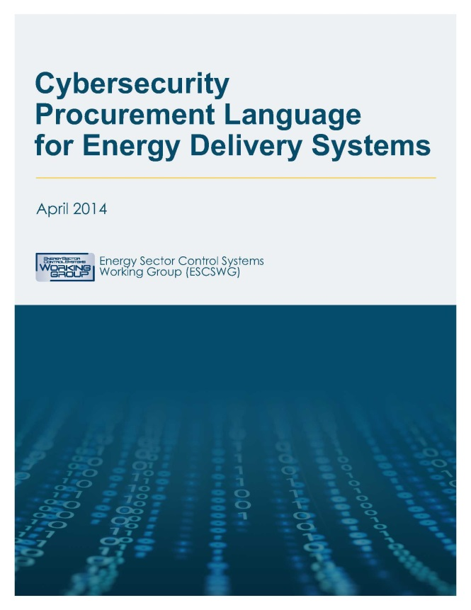
Cybersecurity Procurement Language for Energy Delivery Systems
Issued in 4/2014
Based on Cybersecurity Procurement Language for Control Systems (DOE/DHS 2009)

Slide 34

Cybersecurity Procurement Language for Energy Delivery Systems*
Prepared by the Energy Sector Control Systems Working Group (ESCSWG): DOE, DHS, Duke, EEI, EPRI, FERC, IESO, UTC, APPA, and AGA
“Additionally, feedback was collected from energy sector stakeholders and cybersecurity experts, including acquiring organizations (representing large and small utilities), integrators, vendors, suppliers, consultants, standards organizations, regulators, and cybersecurity researchers during two stakeholder review periods.”
* https://energy.gov/oe/downloads/cybersecurity-procurement-language-energy-delivery-april-2014

Slide 35
Procurement Guidelines
Designed to provide baseline cybersecurity procurement language for:
  Individual components of energy delivery systems (e.g., programmable logic controllers, digital relays, or remote terminal units).
  Individual energy delivery systems (e.g., SCADA system, EMS or DCS)
  Assembled or networked delivery systems (e.g., electrical substation or gas pumping station).
Notes:
So the procurement guidelines are structured to be used as model contract language to be used in the procurement of various energy delivery system assets or in software for such assets.
Given the variety of possible products and services that might come under these guidelines, I imagine the drafters intended for utilities to cut and paste relevant provisions into their procurement contracts

Slide 36
Procurement Guidelines
Key definitions:
  “Acquirer” – purchaser or buyer
  “Supplier” – vendor, seller or manufacturer
  “Integrator” – organization that customizes components, systems and processes
Notes:
As with the NERC reliability standard on supply chain risk management, there is some ambiguity as to who the parties would be
the term Supplier is defined broadly to include a variety of very different entities from vendors and sellers who may not have any role in design to manufacturers who may design certain hardware but may not be involved in decisions on how the hardware is used.
It is interesting to note that these guidelines recognize “Integrators” as an intermediate party in the supply chain, but other than defining them, there are no special terms delineating what specific rights and obligations an integrator might have. The document simply says that an Integrator is sometimes an “acquirer” and sometimes a “seller.”
Punt: “When an energy delivery system contains components from multiple Suppliers, additional cybersecurity procurement language may be required to ensure the secure
delivery and integration of those components.”
“This document does not distinguish between procurement language that may be specific to a Supplier
or an Integrator. Acquirers should consider whether the functions being requested are to be
performed by a Supplier or an Integrator, and then adjust their contract language as appropriate for
each. In some cases, specific language may apply to both Suppliers and Integrators.”

Slide 37
Key Areas
Software and Services
  Access Control
  Account Management
  Session Management
  Authentication/Password Policy and Management
  Logging and Auditing
  Communication Restrictions
  Malware Detection and Protection
  Heartbeat Signals
  Reliability and Adherence to Standards
Notes:
I wont go into detail here about the specific provisions proposed in the guidelines, but here is a list of key areas covered by the guidelines and activities within each area for which the guidelines purport to provide model contract language.
While I’ll provide a few general comments about the model language after this list of areas, I’ll note that these topic headings do provide a reasonably good list of cyber supply chain risk management topics that should be included in a procurement contract.

Slide 38
Key Areas
Life Cycle Security Program
  Secure Development Practices
  Documentation and Tracking of Vulnerabilities
  Problem Reporting
  Patch Management and Updates
  Supplier Personnel Management
  Secure Hardware and Software Delivery
Notes:
Just like the NERC standard, the guidelines suggest that supply chain risk management does not end on the delivery date, but there is an expectation that it would continue for the life of the product or service.

Slide 39
Key Areas
Intrusion Detection
  Host Intrusion Detection
  Network Intrusion Detection
Physical Security
  Physical Access to Energy Delivery System Components
  Perimeter Access
  Communications Inside the Physical Security Perimeter
Wireless Technologies
Cryptographic System Management

Slide 40
Issues with Procurement Guidelines
Definition of Supplier
One-Sided
Level of Specificity
Notes:
So here are my comments
We talked about the definition of supplier and integrators and no real guidance as to handle the differences
Another comment is that the model language is very one sided. All of the provisions reflect obligations of the supplier, without any reference to acquirer obligations. This may be premised on the view that additional obligations of an acquire will affect pricing which is not covered by model language, but that is not clear.
The third comment is that the language varies in specificity from high level comments (I.e., if you have multiple suppliers you need special language) to very specific and rigid language (e.g., the provisions for malware specify that the supplier must provide either host-based malware detection, recommendations on third-party malware detection, or an application whitelisting solution – but alternative malware protections such as utilizing existing customer owned malware protections are not addressed).
Since the procurement language has these concerns, I wont go into any more detail about it, but I recommend that you review it because many utilities rely on it and you are likely to see contract language based on these guidelines.
Any questions?

Slide 41

Beyond the Electric Industry
Notes:
Before wrapping up, I wanted to do a quick survey of how supply chain risk management has crept into cybersecurity discussions in other areas. As noted above, it is a relatively new concept in the electric industry, but it is either emerging or well established in other industries.

Slide 42

Beyond the Electric Industry – Oil and Gas Pipelines
“Establish and document standards for cyber security controls for use in evaluating systems and services for acquisition. Encourage vendors to follow software development standards for trustworthy software throughout the development lifecycle.”
“Incorporate security into cyber system design and operation, whether designing a new system or modifying an existing system. Secure design and operation of SCADA control system architecture is critical for the creation of a sustainable and reliable system.”
TSA, Pipeline Security Guidelines (4/2011) https://www.tsa.gov/sites/default/files/tsapipelinesecurityguidelines-2011.pdf
Notes:
The TSA’s guidelines are relatively old, going back to 2011. But you can see general concerns raised about evaluating cybersecurity controls in the acquisition phase and continuing those controls through the development life cycle.
TSA is currently reviewing its pipeline security guidelines, and like NIST’s revised cybersecurity framework, SCRM will likely figure prominently in any new guidelines coming from the TSA.

Slide 43
Beyond the Electric Industry – Oil and Gas Pipelines
Supply Chain and External Dependencies Management
Establish and maintain controls to manage the cybersecurity risks associated with services and assets that are dependent on external entities, commensurate with the risk to critical infrastructure and organizational objectives.
DOE, Oil and Natural Gas Subsector Cybersecurity Capability Maturity Model (ONG-C2M2) (2/2014)
https://energy.gov/sites/prod/files/2014/03/f13/ONG-C2M2-v1-1_cor.pdf
Notes:
Here’s another reference to encouraging cyber-SCRM.
This comes from the Department of Energy. Much like the NIST Cybersecurity Framework, the DOE’s C2M2 is a tool for gauging the effectiveness of an organizations cybersecurity controls.

Slide 44
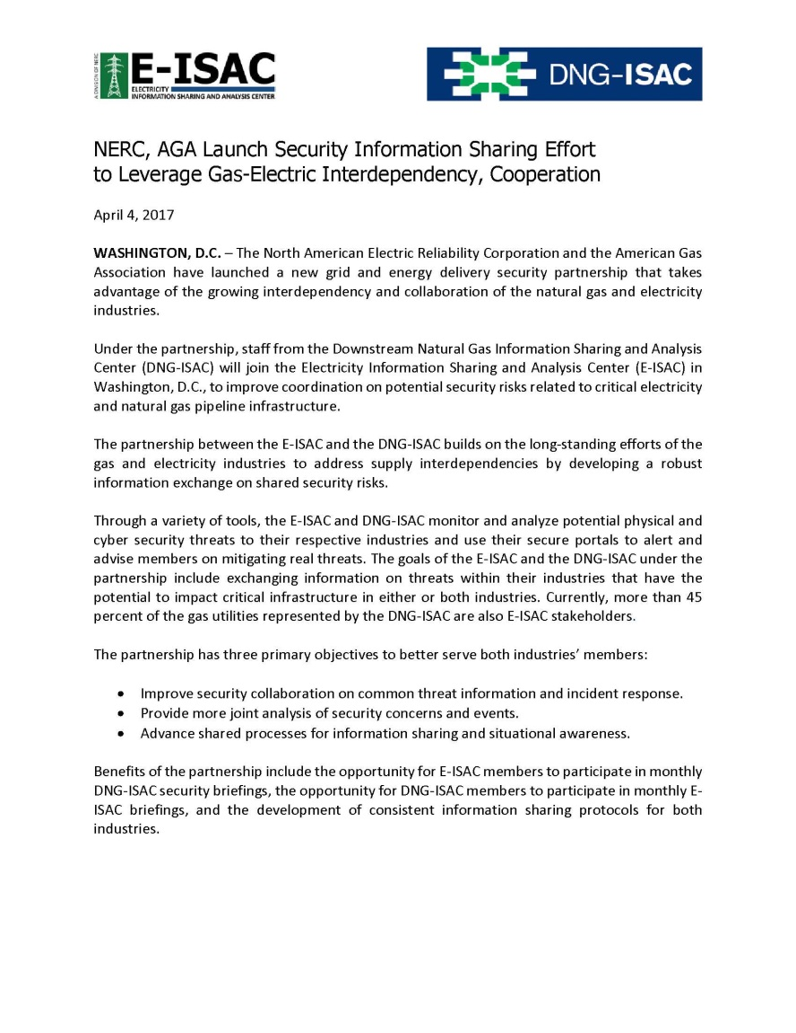
NERC and AGA Working Together
Notes:
And at the distribution level, AGA will be working with NERC on information sharing – likely to lead to cross fertilization of SCRM across the gas and electric industries.
Also note that there is a new group: Energy Sector Critical Manufacturing Working Group (ESCMWG): DOE; DHS; and Coordination Councils – Critical manufacturing, electricity, and oil and natural gas sectors
Expect Critical Manufacturers to be involved in GridEx IV.

Slide 45

Beyond the Electric Industry - Water
“Utilities should develop standard design and implementation requirements that define the testing required by software vendors and system integrators, as well as doing their own testing of the integrity of results.”
Manually initiated access
Service Level Agreements
American Water Works Association Cybersecurity Guidance & Tool. http://www.awwa.org/resources-tools/water-and-wastewater-utility-management/cybersecurity-guidance.aspx (implementation of NIST Cybersecurity Framework and EO 13636)

Slide 46

Beyond the Electric Industry – Government Contracts
Office of the Federal Chief Information Officer (OFCIO – OMB), “Improving Cybersecurity Protections in Federal Acquisitions”
Solicited comments September 10, 2015
Still listed as a draft (https://policy.cio.gov/cybersecurity-protections-in-federal-acquisitions/)
Supply Chain Risk Management Practices for Federal Information Systems and Organizations, NIST Special Publication 800-161, April 2015
Notes:
Security Controls
Cyber Incident Reporting
Information System Security Assessments
Information Security Continuous Monitoring
Business Due Diligence

Slide 47

Beyond the Electric Industry - Banks
Exercise appropriate due diligence in selecting its service providers;
Contract to implement appropriate measures designed to meet the objectives of the Security Guidelines
  Protect against unauthorized access to customer information
  Proper disposal of customer information
Monitor service providers based on risk assessment
  Federal Reserve Board, Interagency Guidelines establishing Information Security Standards, https://www.federalreserve.gov/bankinforeg/interagencyguidelines.htm#vii (promulgated under Section 501(b) of Gramm-Leach-Bliley Act, 15 U.S.C. § 6801)

Slide 48

Beyond Electric Industry – Payment Cards
  “Do not use vendor-supplied defaults for system passwords and other security parameters” PCI DSS Requirement 2
  “Track and monitor all access to network resources and cardholder data” PCI DSS Requirement 10
  “Reviewing hardware and software technologies at least annually to confirm that they continue to be supported by the vendor and can meet the entity’s security requirements, including PCI DSS.” PCI DSS Best Practice 6
PCI Security Standards Council, PCI Data Security Standard, Version 3.2 (April 2016) https://www.pcisecuritystandards.org/documents/PCI_DSS_v3-2.pdf?agreement=true&time=1471019303191

Slide 49


Beyond Electric Industry - Retail
"Like Target, we are a victim of a sophisticated cyber attack operation," said Ross Fazio, president of Fazio Mechanical Services, in a statement. "We are fully cooperating with the Secret Service and Target to identify the possible cause of the breach."
“HVAC vendor eyed as entry point for Target breach” CNN Money (February 7, 2014) http://money.cnn.com/2014/02/06/technology/security/target-breach-hvac/index.html
Notes:
This feels like ancient history, but if you go back to the Target data breach in 2014, the one that got all the headlines – theft of information from 70 million shoppers
That hack was actually a prime example of supply chain risks, since the hackers used a HVAC vendor to find a back door into Target’s IT systems.

Slide 50

Beyond the Electric Industry – Consumer Goods
“While supply chain risk management may be a relatively new concept for many organizations, it has been a board-driven initiative at P&G since 2000.”
“For P&G, the business continuity efforts are seen as ‘insurance’ for the business. The program enables them to protect their critical assets and systems in a cost effective way.”
NIST, US Resilience Project, Best Practices in Cyber Supply Chain Risk Management, Procter & Gamble Excellence in Supply Chain Risk Management http://www.nist.gov/itl/csd/upload/NIST_USRP-P-G-Cyber-SCRM-Case-Study.pdf
Notes:
This is a plug for our firm’s long standing clients
As you can see they have taken supply chain risk management seriously for nearly two decades.

Slide 51
Beyond the Federal – State Utility Regulation
NARUC, A Primer for State Utility Regulators Version 3.0 (January 2017)* - “Although the information of procurement seen upstream to vendors may only be proprietary to the
utility, the decisions the vendor makes around procurement may contain key elements for cybersecurity.”
*https://pubs.naruc.org/pub/66D17AE4-A46F-B543-58EF-68B04E8B180F
Notes:
31. Has your organization conducted an evaluation of the cybersecurity risks for major systems at each stage of the system deployment lifecycle? What has been done with the results?
32. Are cybersecurity criteria used for vendor and device selection?
33. Have vendors documented and independently verified their cybersecurity controls? Who is the verifier and how are they qualified?
34. Are there third-party providers of services whose cybersecurity controls are beyond the ability of your organization to monitor, understand, or assure? Has your organization explored whether these may create cybersecurity vulnerabilities to your operations?
35. Does your organization perform vulnerability assessment activities as part of the
acquisition cycle for products in each of the following areas: cybersecurity, SCADA, smart grid, internet connectivity, and website hosting?
36. Has the company managed cybersecurity in the replacement and upgrade cycle of its networked equipment? Does this include smart meters?
37. What kind of guidance do you follow to ensure that your procurement language is both specific and comprehensive enough to result in acquiring secure components and systems?
(Note: Does your company include Cyber Security Procurement Language for Control
Systems within its Procurement Language? Available at http://www.uscert.
gov/control_systems/pdf/FINAL-Procurement_Language_Rev4_100809.pdf IEC

Slide 52
Pulling it all together …
Although cyber SCRM seems to be a focus of the electric industry in recent years, it is neither new nor is it confined to that industry
Although cyber SCRM standards and requirements appear to be aimed at buyers, they will necessarily affect relationships with suppliers
Notes:
So let’s wrap up

Slide 53
Things to watch for…
  Validating security of hardware and software prior to deployment
  Adding security as a design requirement
  Life cycle support
  Restrictions on remote access
  Collaboration on threats and incidents
  Authentication of software updates

Slide 54
Several key issues…
  Recognizing differences among “suppliers”: vendors, manufacturers, consultants
  Recognizing upstream and downstream supply chain risks
  Different industries, different companies, different requirements
  Getting a seat at the table
    Practical input
    Avoiding one-sided standards
    Insurability?

Slide 56
Thank you for your time!
QUESTIONS?
This concludes the educational content of this activity

