Slide 1
Wright State H-1B Investigation
Ohio Attorney General’s Twenty-Seventh Annual
Conference for Public College and University Attorneys

Slide 2
Presented By
Ashley Barbone, Assistant Attorney General, Ohio Attorney General’s Office
Larry Chan, Vice President for Legal Affairs and General Counsel, Wright State University
D. Michael Crites, Partner, Dinsmore & Shohl
Jennie Ferguson, Partner, Dinsmore & Shohl
Pamela Vest Boratyn, Assistant Director of Business & Human Resources/Chief of Staff, Ohio Department of Transportation

Slide 3
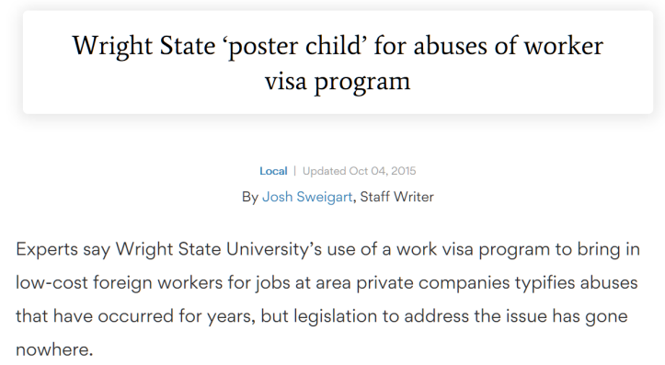
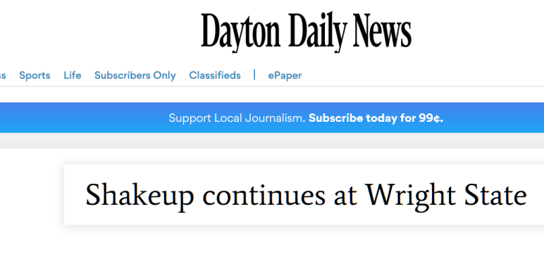
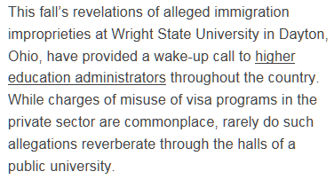
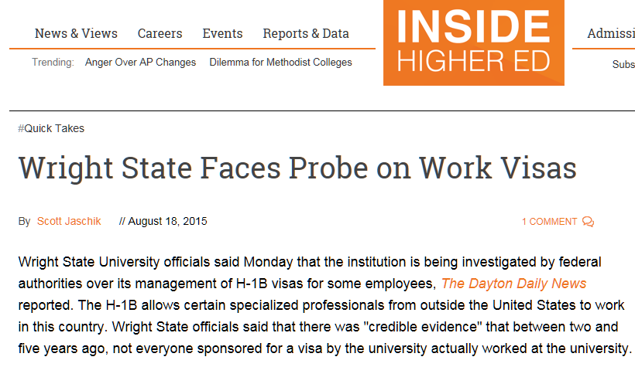
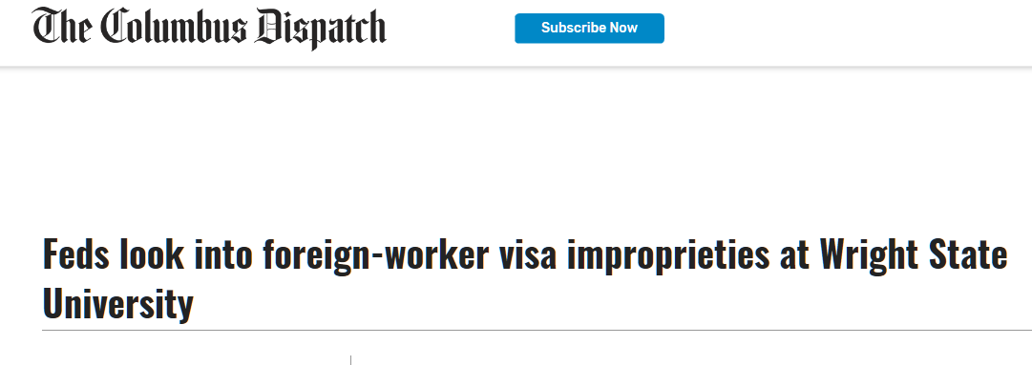
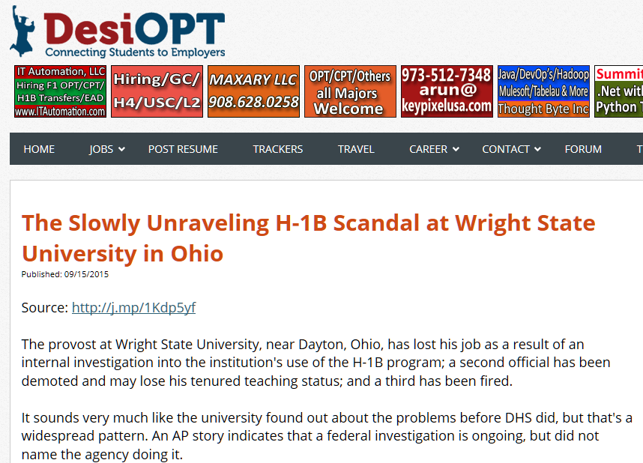

Slide 4
H-1B
Specialty Occupation Classification

Slide 5
H-1B Numerical Limitations
Regular Cap: 65,000
U.S. Master’s Cap: 20,000
Cap Exempt: Institutions of Higher Education
H-1B Cap FY 2020:
201,011 Petitions Received
Notes:
There is a cap on the number of new H-1Bs that can be issued each year (65,000).
Additionally, there is an exemption for up to 20,000 H-1B visas that have U.S. master’s degrees
Institutions of higher education are exempt from the numerical limitations for H-1B visas
Can file as many H-1Bs as needed at any time of year
201,011 petitions filed.

Slide 6
How Petitions Were Filed
Wright State
(Employer)
Work at WSU
Project for WSU
FALSE
Supervised by WSU
Wright State
(Employer)
Web Yoga
(Mid Vendor)
End Client/s (GA, NY, FL, etc.)

Slide 7
Employer-Employee Relationship
Fire
Supervise
Pay
Other control
Hire
Notes:
Must have an employee-employer relationship whereby the employer has the right to “hire, pay, fire, supervise, or otherwise control the work of any such employee.”
Must have right to control regardless of where the employee is physically working
Right to control the duration, tools, location, work hours, benefits, etc.

Slide 8
Employer-Employee Relationship at Third-Party Work Site
Mid Vendor
End Client
Employer/Petitioner
Contracts
Statements of Work
Work Orders
Project description
Mid Vendor Letter
Contracts
Statements of Work
Work Orders
Project description
End Client Letter

Slide 9
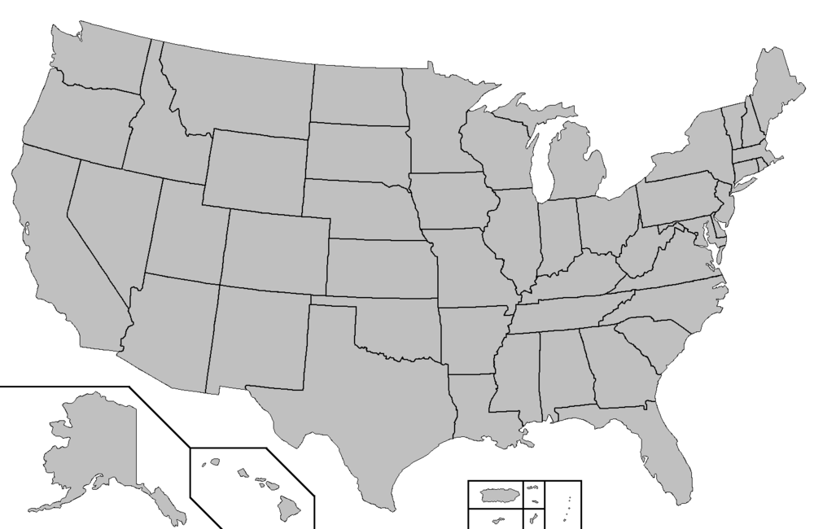
Identify Work Location(s) and Wages
$64,251 - ACWIA
$71,344
$70,803 -ACWIA
$77,334
*Wages are used as an example only and based on 2018-2019 data
Notes:
Must pay required wages – higher of actual wage or PW in the occupation at the place of employment
DOL has a database it uses – two subsets – one database is for institutions of higher education (under the regs, the wage only takes into account wages paid to emEs at other institutions of higher education in the MSA)
EXAMPLE:
Required wages for Software Systems Developer (Level 1) in Dayton using ACWIA – Higher Education Database wages is $64,251
Required wages for Software Systems Developer (Level 1) in Dayton using All Industries database wages is $71,344
Required wages for Software Systems Developer (Level 1) in New York City using ACWIA wages is $70,803
Required wages for Software Systems Developer (Level 1) in New York City using All Industries database wages is $77,334

Slide 10
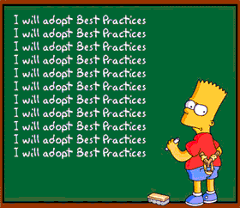
Initial Steps
Reviewed Immigration Files
Reviewed Processes and Policies
Identified Best Practices

Slide 11
Special Counsel for Wright State University
D. Michael Crites, Esq.
michael.crites@dinsmore.com
Jennie K. Ferguson, Esq.
jennie.ferguson@dinsmore.com
Notes:
Cover – Photo option (Blue & White options available)
No-bar photo option available as well

Slide 12
The WSU Investigation
Communications with the Government
United States Attorney’s Office
Investigating Government Agencies
Identifying who is the target of the investigation
Cooperation
Authorization from Board of Trustees
Document Productions and Witness Interviews
Sharing internal investigation results
Notes:
Content Slide – Style 1

Slide 13
The WSU Investigation
Internal Investigation by Special Counsel
Collaboration with General Counsel’s Office
Audits by Forensic Firms
Consulting on Compliance Programs
Crisis Management
Using the Principles of Federal Prosecution
Key factors to investigate and to identify during the investigation
Notes:
Content Slide – Style 1

Slide 14
The WSU Investigation
Principles of Federal Prosecution
Nature and seriousness of offense
Persuasiveness of wrongdoing within in the corporation
History of similar misconduct
Cooperation
Corporate Compliance Program
Justice Manual, 9-28.300
Timely and voluntary disclosure of wrongdoing
Remedial action
Collateral consequences
Adequacy of regulatory or civil actions
Adequacy of prosecution of responsible individuals
https://www.justice.gov/jm/jm-9-28000-principles-federal-prosecution-business-organizations

Slide 15
The WSU Investigation
Report on Findings of Investigation
Executive Session with Board of Trustees
Authorization for Disclosure
Sharing the Findings with the Government
Presentations
Proffers
Proposals

Slide 16
The WSU Investigation
Negotiating a Resolution
Structure Proposal based upon Principles of Federal Prosecution
Understanding Collateral Consequences
Financial Remuneration
Global Resolution
Non-Prosecution Agreement

Slide 17
