Slide 1




THE INTERSECTION OF CRIMINAL AND ADMINISTRATIVE LAW
Columbus Bar Association Criminal Law Practice Group
October 22, 2026
BEGIN

Slide 2






Today’s
Presenter
Daniel S. Zinsmaster, Esq.
Dinsmore & Shohl, LLP (614) 628-6949
daniel.zinsmaster@dinsmore.com

Slide 3



What agencies regulate healthcare professionals in Ohio?
How does the R.C. Chapter 119 disciplinary process operate?
Where does administrative law and criminal law intersect in Ohio?
Special reporting duties for prosecutors
Damage control best practices
Today’s
Agenda

Slide 4
What Agencies Regulate Healthcare Professionals in Ohio?
DINSMORE & SHOHL LLP • LEGAL COUNSEL • DINSMORE.COM
© 2026. ALL RIGHTS RESERVED

Slide 5

Regulates the practice of allopathic physicians (MD), osteopathic physicians (DO), podiatric physicians (DPM), and massage therapists (LMT) under the authority of the Medical Practices Act, R.C. Chapter 4731
Also regulates physician assistants, dietitians, anesthesiologist assistants, respiratory care
professionals, acupuncturists, radiologist assistants, and genetic counselors
Over 100,000 active licensees total
Board is comprised of 12 members: 9 physicians (7 MD, 1 DO, 1 DPM) and 3 non-physician public members
Members are appointed by the Governor and serve 5-year terms; terms are staggered to
provide continuity and members may be reappointed
2 members are selected by their peers on the Board to serve as the Board’s Secretary and Supervising Member to oversee the Board’s investigatory, enforcement, and compliance processes

Slide 6
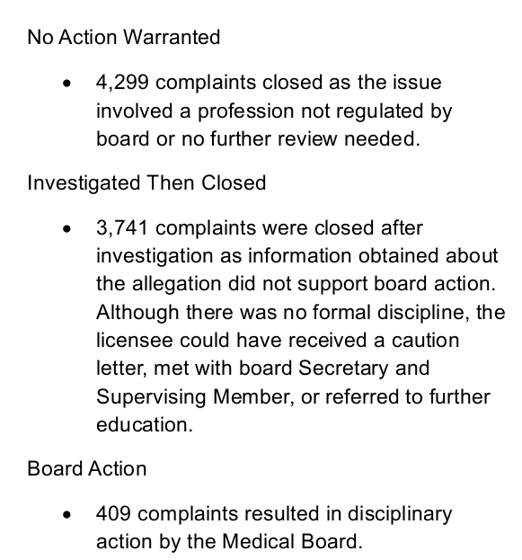
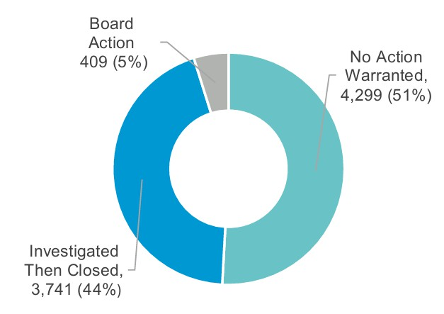

Slide 7

Regulates registered nurses (RNs), licensed practical nurses (LPNs), advanced practice registered nurses (APRNs), dialysis technicians (DTs), certified community health workers (CHWs), certified medication aides (CMAs), and certified doulas
Authority pursuant to the Nurse Practice Act, R.C. Chapter 4729
Over 330,000 active licensees total
Board is comprised of 13 members, including 8 RNs (two of which must be APRNs), 4 LPNs, and 1 consumer member
Members are appointed by the Governor and serve 4-year terms; terms are staggered to
provide continuity, and members may be reappointed once
1 member is selected by his/her peers on the Board to serve as the Board’s Supervising Member and oversee the Board’s disciplinary processes

Slide 8

According to the Nursing Board’s FY 2025 annual report, over 8000 complaints were investigated
663 Board actions were taken in FY2025
Board also had over 1000 active compliance cases in which the Board provided monitoring and oversight to assure licensees fulfilled the terms and conditions of their consent agreements or Board orders

Slide 9




Other R.C. Chapter 119 healthcare agencies in Ohio:
Ohio Board of Pharmacy
Ohio Counselor, Social Worker, and Marriage and
Family Therapist Board
Ohio Chemical Dependency Professionals Board
Ohio State Dental Board
Ohio Board of Psychology
Ohio State Chiropractic Board
Ohio Vision Professionals Board
Ohio Veterinary Medical Licensing Board

Slide 10
How Does the R.C. Chapter 119 Disciplinary Process Operate?
DINSMORE & SHOHL LLP • LEGAL COUNSEL • DINSMORE.COM
© 2026. ALL RIGHTS RESERVED

Slide 11

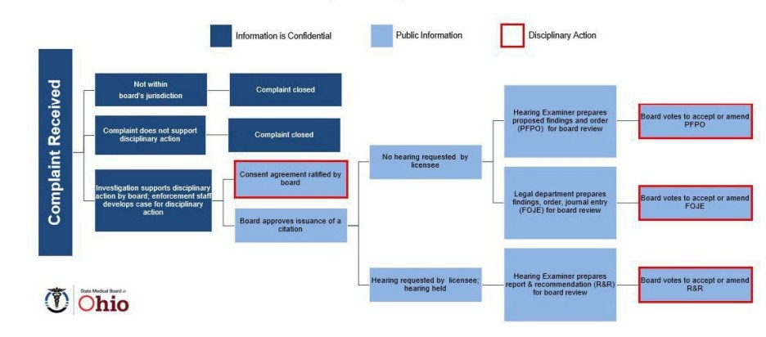
Investigatory and Enforcement Process
10

Slide 12

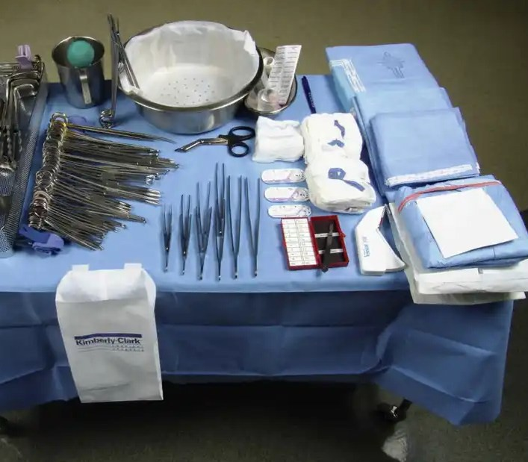
Investigative Tools
Records subpoena
Interrogatories Informal interview
Formal office conference
Deposition
Request for written statement
Site visit / inspection
DINSMORE & SHOHL LLP • LEGAL COUNSEL • DINSMORE.COM
© 2026. ALL RIGHTS RESERVED
11

Slide 13

Is there a Statute of Limitations?
R.C. Chapter 119 does not contain a statute of limitations!
Agencies sometimes become aware of information / institute charges long after the events occurred
Delay does not affect most agency actions. Ohio St. Bd. of Pharmacy v. Frantz (1990), 51 Ohio St.3d 143; McCutcheon v. State Med. Bd. of Ohio (1989), 65 Ohio App.3d 49

Slide 14
Excessive Delays May Violate Due Process
However, agency discretion to bring actions related to past events may not be completely unfettered
Pre-hearing suspensions may not be justifiable if the events in question are old or due to investigatory delay
For example, in Angerman v. State Med. Bd. of Ohio, Franklin C.P. Nos. 89CV-01-64 and 88CV-12-8615 (July 3, 1989), the court found the issuance of a summary suspension more than one year after it had knowledge of the licensee’s practice violations was unconstitutional

Slide 15
Appellate Rights (R.C. § 119.12)
Notice of appeal must be filed both with the licensing board and court of common pleas within 15 days of mailing of final order
Standard of review: whether the order is (A) supported by reliable, probative, and substantial evidence and (B) in accordance with law
Respondent-Appellant may also seek further review by court of appeals
Standard of review: whether court of common pleas abused its discretion, but de novo standard for legal issues

Slide 16
Where Does Administrative Law and Criminal Law Intersect in Ohio?
DINSMORE & SHOHL LLP • LEGAL COUNSEL • DINSMORE.COM
© 2026. ALL RIGHTS RESERVED

Slide 17



Double Jeopardy
“[N]or shall any person be subject for the same offense to be twice put in jeopardy of life or limb”
Double jeopardy is not applicable to R.C.
Chapter 119 administrative actions
Rationale: administrative action is specifically authorized by statute and does not constitute a bar against criminal prosecution based on the facts that underlie both actions

Slide 18
Duty to Cooperate
Pursuant to R.C. § 4731.22(B)(34), licensees are required to cooperate in a Medical Board investigation
Failure to comply with a subpoena or order issued by the Board or failure to answer truthfully a question presented by the Board in an investigative interview, an investigative office conference, at a deposition, or in written interrogatories, can be the basis for Medical Board disciplinary action
Recommended discipline for failure to cooperate:
indefinite suspension plus fine of at least $3000

Slide 19
Duty to Cooperate Cont’d
Board of Nursing – see R.C. § 4723.28(B)(39)
Discipline may be imposed for “[f]ailure to cooperate with an investigation conducted by the board under this chapter, including failure to comply with a subpoena or order issued by the board or failure to answer truthfully a question presented by the board in an investigative interview, in an investigative office conference, at a deposition, or in written interrogatories, except that failure to cooperate with an investigation does not constitute grounds for discipline if a court of competent jurisdiction has issued an order that either quashes a subpoena or permits the individual to withhold testimony or evidence at issue.”

Slide 20

Duty to Cooperate Cont’d
For the Ohio Board of Pharmacy, the duty to cooperate is less explicit as the statutory provisions for the Medical and Nursing Board, but exists nonetheless
Duty extends to individual practitioners (pharmacists and pharm techs) as well as to licensed entities (TDDD and WDDD)
  Any health care practice that possesses medications for distribution to patients, including free samples, must have a TDDD
Note that the Pharmacy Board is unique in that it can pursue administrative / licensure matters per R.C. Chapter 4729 and conduct criminal investigations per its authority under R.C. Chapters 2925, 3715, and 3719

Slide 21
Confidentiality of Records
Investigations by the Medical Board are confidential
  R.C. 4731.22(F)
The licensee is not entitled to a copy of the complaint, the complainant’s identity, or any investigative records
As the investigation is confidential, it is not subject
to disclosure pursuant to Ohio’s Public Records Act
The existence of the investigation (without any formal discipline) will not appear on the Medical Board’s website
However . . .

Slide 22
Confidentiality of Records Continued
While investigations are confidential, under R.C. 4731.22(F)(5), the Medical Board may “share any information it received pursuant to an investigation or inspection… with law enforcement agencies [and] other licensing agencies”
Be aware!!! Statements provided to administrative agencies as part of an investigation can and likely will be shared with local law enforcement or other licensing boards

Slide 23
5th Amendment: Right against Self-incrimination
Fifth Amendment to the U.S. Constitution provides that no person “shall be compelled in any criminal case to be a witness against himself”
Article 1, Section 10 of the Ohio Constitution provides
the same protection: “No person shall be compelled,
in any criminal case, to be a witness against himself”
But what about a licensee’s duty to cooperate with the
Medical Board?

Slide 24
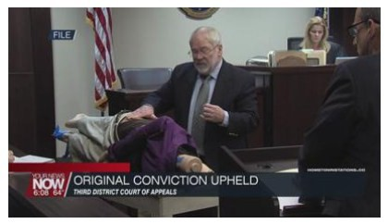
Right against Self- incrimination and the Gideon Case
State v. Gideon, 165 Ohio St.3d 142, 2020-Ohio-5635
Question presented: whether the State may use incriminating answers given by a doctor during a Medical Board investigation in a subsequent criminal prosecution of that doctor?
In 2017, three of Dr. Gideon’s rheumatology patients accused him of inappropriately touching them during office visits
Two investigations were opened: one by the local police and one by an investigator working for the Medical Board

Slide 25
Right against Self- incrimination and the Gideon Case
Although Dr. Gideon told the police that he did not inappropriately touch any patients, the Medical Board investigator indicated to the police that Dr. Gideon had admitted to misconduct
The investigator shared that information with the police pursuant to R.C. § 4731.22(F)(5) and Dr. Gideon was later charged with 3 misdemeanor counts of sexual imposition
Dr. Gideon moved to suppress the statements, arguing that he was compelled to answer the investigator’s questions or risk losing his medical license in violation of his 5th Amendment rights

Slide 26
Right against Self- incrimination and the Gideon Case
Trial court denied the motion to suppress, concluding that Dr. Gideon “made voluntary statements during a noncustodial interview”
A jury found Dr. Gideon guilty on all three counts
Third District Court of Appeals reversed the convictions consistent with Garrity v. New Jersey (1967), 385 U.S. 493, which held that statements obtained from a public employee under threat of job loss are unconstitutionally coerced and inadmissible in subsequent criminal proceedings

Slide 27
Right against Self- incrimination and the Gideon Case
Supreme Court of Ohio reversed the decision by the Third District
“We conclude that a medical license is a property right and that the threatened loss of the license is a form of coercion that can compromise the . . . Fifth Amendment privilege against self-incrimination”
“That said, in order for coercion to be sufficient to warrant the suppression of statements made during a medical-board investigative interview, it must be both subjectively believed and objectively reasonable”

Slide 28
Right against Self- incrimination and the Gideon Case
Competent, credible evidence supported the trial court’s factual finding that the doctor did not objectively believe that a refusal to answer truthful questions posed by the Medical Board investigator could lead to the loss of his medical license
Dr. Gideon did not establish that coercive action by the investigator had occurred
The trial court found no evidence that the investigator informed Dr. Gideon that “he must waive his rights against self-incrimination or subject himself to discharge or revocation of his license”
Neither Dr. Gideon nor the investigator mentioned during the interview anything that suggested Dr. Gideon could lose his medical license if he refused to comply with the investigator’s questioning

Slide 29
Judge Donnelly’s Dissent in the Gideon Case
The combination of Dr. Gideon’s duty to cooperate under R.C. § 4731.22(B)(34) and the investigator’s process in this case exceeded an ordinary job pressure to cooperate
Case was classified as “joint investigation” by
investigator
Investigator was posing as a “straw man” to effectuate law enforcement’s criminal investigation
At the conclusion of Dr. Gideon’s interview, instead of reporting back to the Medical Board, the investigator immediately went to the local police department to report Dr. Gideon’s confessions to law enforcement

Slide 30

Licensure Ramifications of Criminal Convictions
Licensure agencies can typically take disciplinary actions for a plea of guilty to, a judicial finding of guilt of, or a judicial finding of eligibility for intervention in lieu of conviction for:
  Felony
  Misdemeanor in course of practice
  Misdemeanor involving moral turpitude
  Commission of an act that constitutes a felony
  Commission of an act involving moral
turpitude that constitutes a misdemeanor

Slide 31

Tangential Ramifications of Criminal Convictions
⬇ Consent agreements and adjudicatory orders generally require reporting to various third-party entities within 30-days of the effective date of the action
⬇ Typical third parties:
Other state boards
DEA
Medicare / Medicaid
Private insurers / CAQH
Specialty certifying boards (e.g.,
ABMS; AOA, APMA, etc.)
Employer(s) and affiliated medical centers
NPDB
⬇ Some third parties have their own bylaws and guidelines requiring reporting within certain specified time periods of adverse actions, including criminal matters, license discipline, malpractice actions, etc.

Slide 32

Mandatory Reporting of Criminal Conduct
Historically, most licensed healthcare professionals disclosed criminal charges and/or convictions on license applications or renewals
Recent push to create additional mandatory duty to report within 30-days of filing:
  Nursing Board: 30-days to report
convictions per OAC 4723-7-08
  Pharmacy Board: 10-days to report convictions per OAC 4729:1-4-02

Slide 33
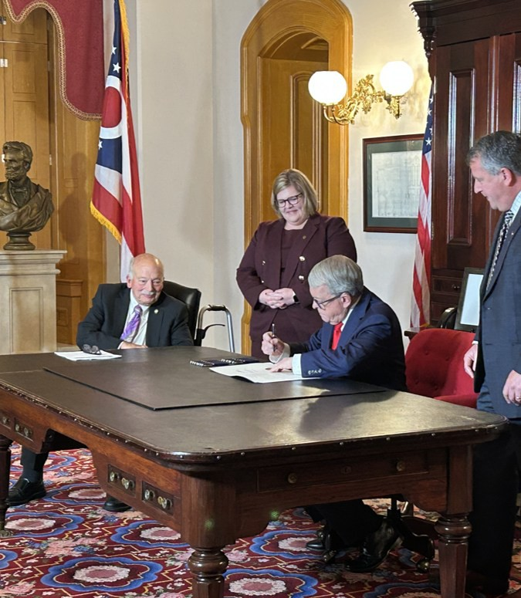
Mandatory Reporting of Criminal Conduct
After becoming effective in April 2025, S.B. 109 brought about some transformative changes to Medical Board licensees:
⬇ Expands duty of licensed providers to report criminal conduct or sexual misconduct
⬇ Requires licensed providers to self-report criminal charges, alleged sexual misconduct, and OVI’s
⬇ Authorizes the Board to suspend a license for pending criminal charges
⬇ And more…

Slide 34

Mandatory Reporting of Criminal Conduct
S.B. 109 law changes now mandate Medical Board licensees that have reasonable cause to suspect that another licensee has committed or participated in criminal conduct or sexual misconduct to report that information to the Board
S.B. 109 was driven by OSUWMC / Dr. Richard Stauss matter
"Criminal conduct" – conduct that constitutes a felony, a misdemeanor committed in
the course of medical practice, an offense of violence, or a sexually oriented offense
A charge or indictment is not required to trigger duty to report
Potential ways physician can have “reasonable cause to suspect”:
Credentialing disclosures
Communications
Civil protection orders
Source does not matter

Slide 35
Failure to Report is a Crime
S.B. 109 expands the offense of failure to report a crime by prohibiting any person who knows that a licensed medical professional has committed an offense under the Sex Offenses Law (R.C. Chapter 2907) against a patient from failing to report such knowledge to law enforcement authorities within 30 days of obtaining the knowledge
  R.C. 2921.22(F)(1)
  A violation is a fourth-degree misdemeanor
  Grants civil or criminal immunity generally to a person for making a report so long as the person is acting in good faith without fraud or malice
No Privilege: Provides that the physician-patient relationship or physician assistant-patient relationship is not a ground for excluding evidence against the medical professional in any judicial proceeding
Double Duty? May have duty to report to Board and law enforcement as to the same occurrence!

Slide 36

Self- Reporting (Medical Board Licensees)
S.B. 109 now requires licensees to report to the Board criminal charges regarding criminal conduct, sexual misconduct, or any conduct involving the use of a motor vehicle while under the influence of alcohol or drugs
Previously reported on license renewals; now an affirmative duty to report
Charges must be self-reported within 30-days
https://med.ohio.gov/help-center/file-a-complaint

Slide 37
Suspension for Pending Crimes
S.B. 109 now authorizes the Medical Board to suspend a license without a prior hearing if the Board receives verifiable information that a licensee has been charged with a felony and the conduct charged constitutes a disciplinary violation under Ohio law
R.C. 4731.22(B)(9) – The Board may discipline a licensee for “a plea of guilty to, a judicial finding of guilt of, or a judicial finding of eligibility for intervention in lieu of conviction for, a felony”
Certified copy of criminal case documents
New prosecutor reporting duties to the Board
  Not just convictions; but now indictments too

Slide 38
Special Reporting Duties for Prosecutors
DINSMORE & SHOHL LLP • LEGAL COUNSEL • DINSMORE.COM
© 2026. ALL RIGHTS RESERVED

Slide 39

Prosecutor Reporting Duties (General)
R.C. 2929.42(A) – The prosecutor in any case against a person licensed under R.C. Chapters 3719, 4715, 4723, 4729, 4730, 4731,
4734, 4741, 4759, 4760, 4761, 4762, 4772,
4774, or 4778 shall notify the appropriate licensing board of any of the following convictions:
Felony
Misdemeanor committed in the course of practice
Misdemeanor involving moral turpitude

Slide 40
Prosecutor Reporting Duties (Drug Offenses)
R.C. 3719.12 – Prosecutor shall report the conviction of a manufacturer, wholesaler, outsourcing facility, repackager of dangerous drugs, TDDD, RPh, Pharm Tech, DDS, DC, MD/DO, DPM, RN, LPN, PA, OD, or DVM of a
violation of R.C. Chapters 2925 and/or 3719 to the board that licensed, certified, or registered the person to practice or to carry on business
Immediate Suspension: Within 30 days of the receipt, agency shall initiate action in accordance with R.C. Chapter 119 to suspend or revoke the person's license, certificate, or registration

Slide 41
Prosecutor Reporting Duties (Sexual Battery)
Changes per S.B. 109 require that if a licensed medical professional is indicted or charged with sexual battery, the prosecuting attorney must send written notice of the indictment or the charge to the regulatory or licensing board or agency, if any, that has the administrative authority to suspend or revoke the licensed
medical professional’s professional license,
certification, registration, or authorization
RC 2907.03(A)(11) and 2907.17

Slide 42
Damage Control Best Practices
DINSMORE & SHOHL LLP • LEGAL COUNSEL • DINSMORE.COM
© 2026. ALL RIGHTS RESERVED

Slide 43

Managing and mitigating adverse professional consequences stemming from criminal cases?
Identify the type of professional and pertinent licensing agency/ies
Review potential reporting duties
Discuss cooperation v. incrimination
Analyze prospective employment and credentialing implications
Assess foreseeable license discipline stemming from potential criminal plea / trial outcome
Develop mitigating circumstances /
evidence
DINSMORE & SHOHL LLP • LEGAL COUNSEL • DINSMORE.COM
42
© 2026. ALL RIGHTS RESERVED

Slide 44





Daniel S. Zinsmaster, Esq.
Questions?
Dinsmore & Shohl, LLP Columbus, Ohio
614-628-6949
daniel.zinsmaster@dinsmore.com

Slide 45

D I N S M O R E & S H O H L L L P / L E G A L C O U N S E L
© 2026. ALL RIGHTS RESERVED.

